Slide 1
Build a Watson AI Chatbot from Db2
Sanjula Ganepola, IBM
Software Developer
IBM i Development Tools and AI
Sanjula.Ganepola@ibm.com

Slide 2
Agenda
Overview of Watsonx Assistant
Planning Your Assistant
Terminology You Should Know
Let’s Build a Chatbot
Integrate with Db2
Next Steps

Slide 3
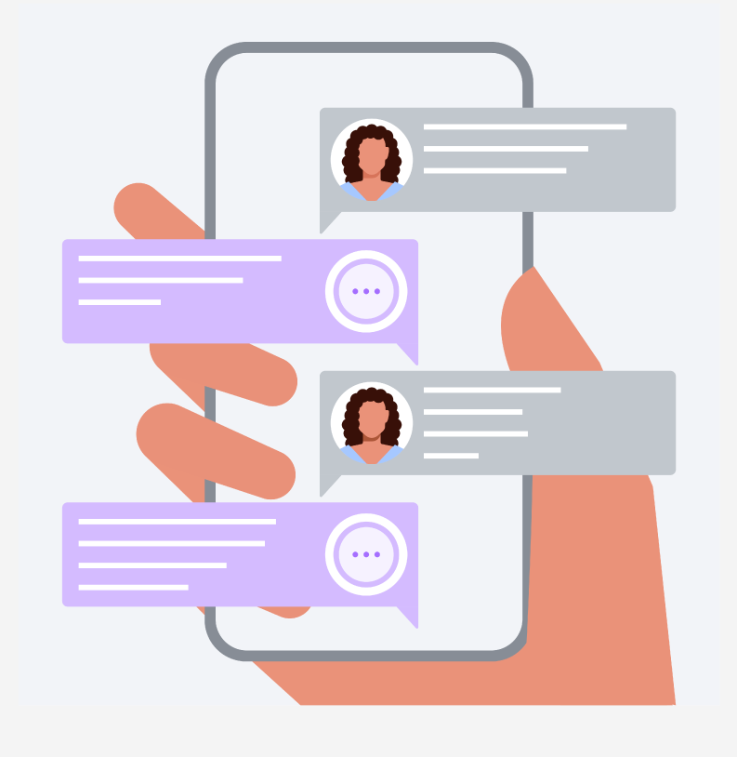
Have you ever built a chatbot?
Choose 1:
Yes, with Watsonx Assistant
Yes, with another tool
No, but we want to
No, we don’t want to
No, never thought about it

Slide 4
Overview of Watsonx Assistant

Slide 5
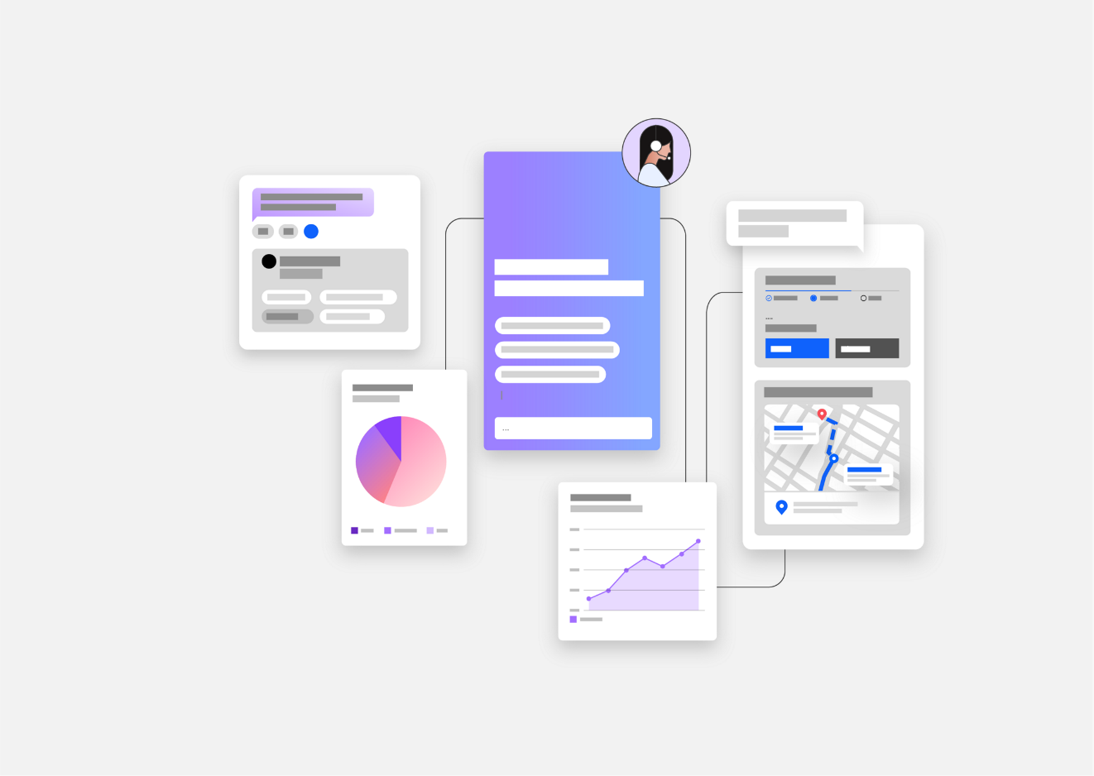
What is Watsonx Assistant?
“Conversational AI solution that empowers anyone to effortlessly build generative AI Assistants that deliver frictionless self-service experiences to customers”
↓
Use Watsonx Assistant to build your own branded live chatbot
💻 Bring the assistant to your customers, where they are
🧠 Create AI-driven conversational flows
📑 Embed existing help content
🤝 Connect to your customer service teams
🎯 Track customer engagement and satisfaction

Slide 6
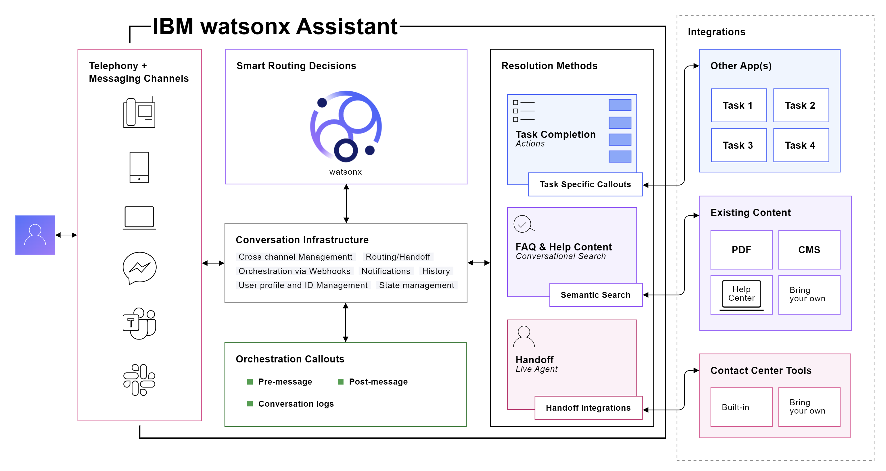
How Does It Work?

Slide 7
Planning Your Assistant

Slide 8
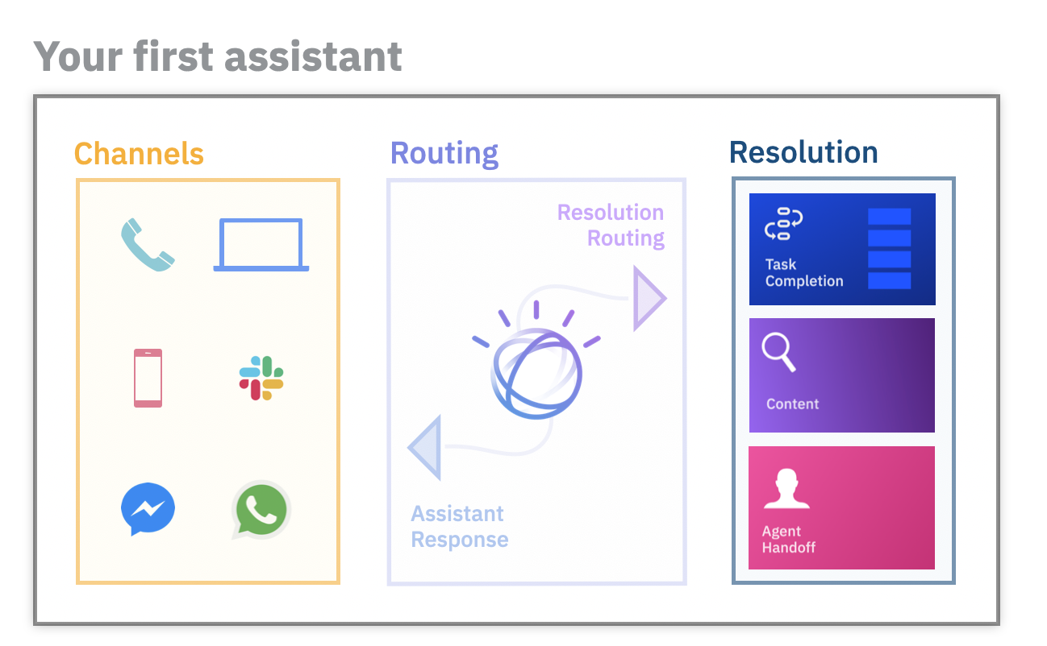
Before building an assistant…
Select an initial channel
Where will customers use your assistant?
Select starting domain
What topic domain can your assistant unify and automate?
Outline frequent topics
What are the most frequent topics which are mostly informational in nature?
Collect content sources
What help content is available to customers today?
Plan handoff strategy
How should customers be routed to human agents?

Slide 9
Terminology You Should Know

Slide 10
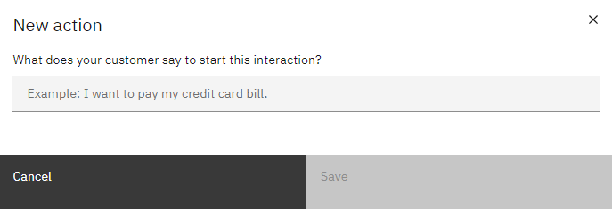
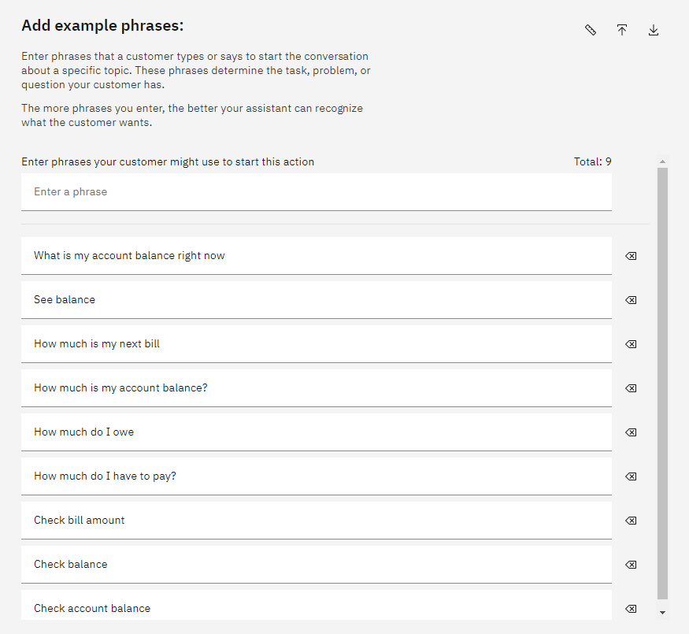
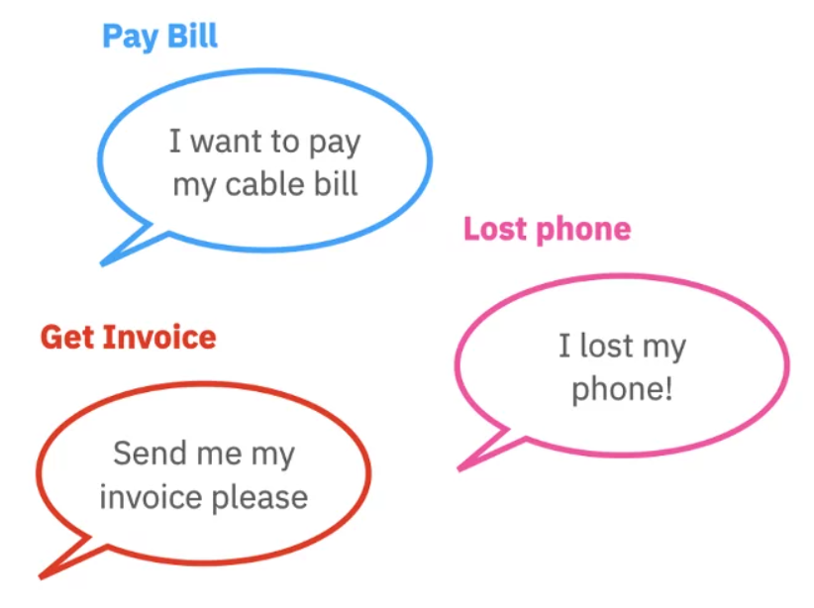
What are Actions and Phrases?
An action is a problem or a task that your customer wants to resolve
Phrases are what customers type or say to start an action
Add multiple phrases to better train your assistant to recognize what customers want

Slide 11
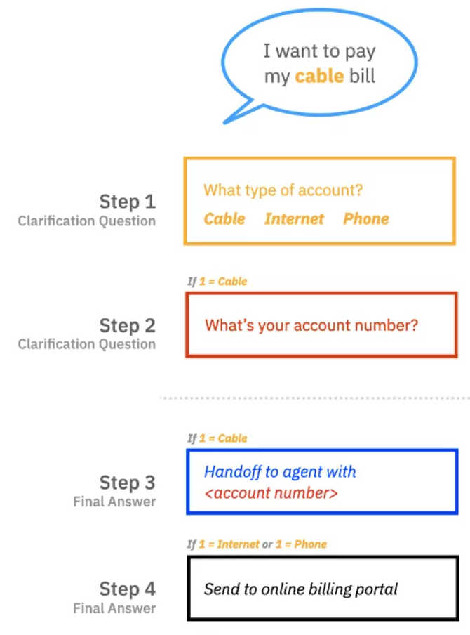
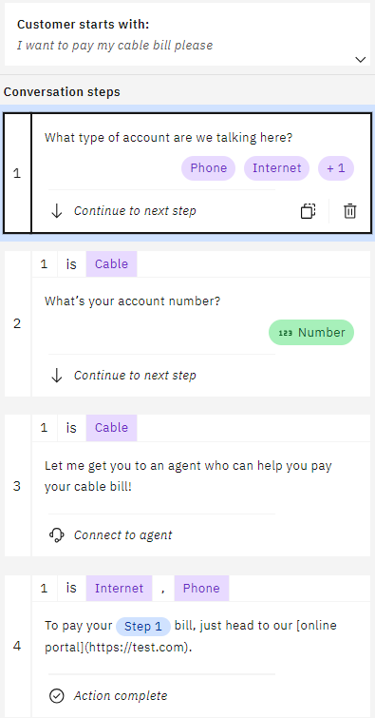
What are Steps and Conditions?
A step is a back-and-forth interaction between your assistant and your customer
Conditions are requirements which must be met for the step to be triggered

Slide 12
Let’s Build a Chatbot

Slide 13




Demo Example – ConnectMe Inc.
ConnectMe Inc. is a telecommunications company with cable, internet, and phone services
ConnectMe Inc.
Goals
Streamline bill payment services
Update account data in real-time
Provide 24/7 support
Customer A
Support Rep A
Database
Customer B
Support Rep B
FAQ Manual

Slide 14
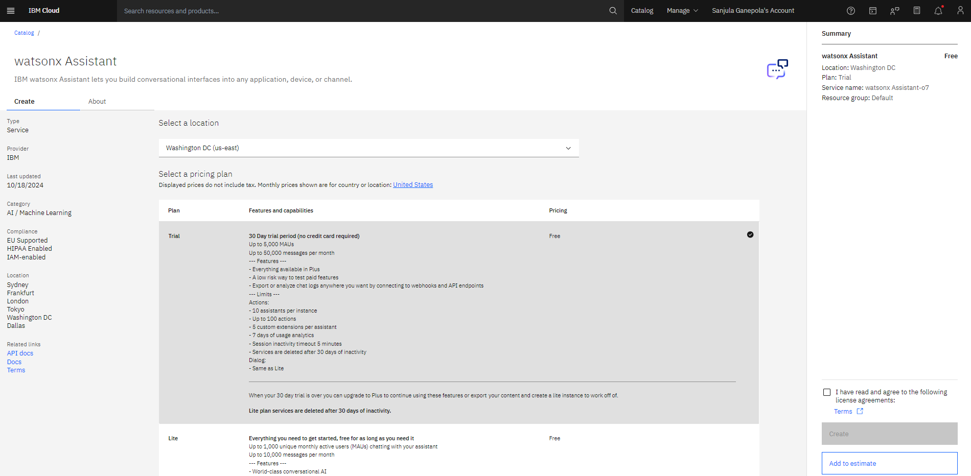
Create Watsonx Assistant Instance
💡30 DAY TRIAL!

Slide 15
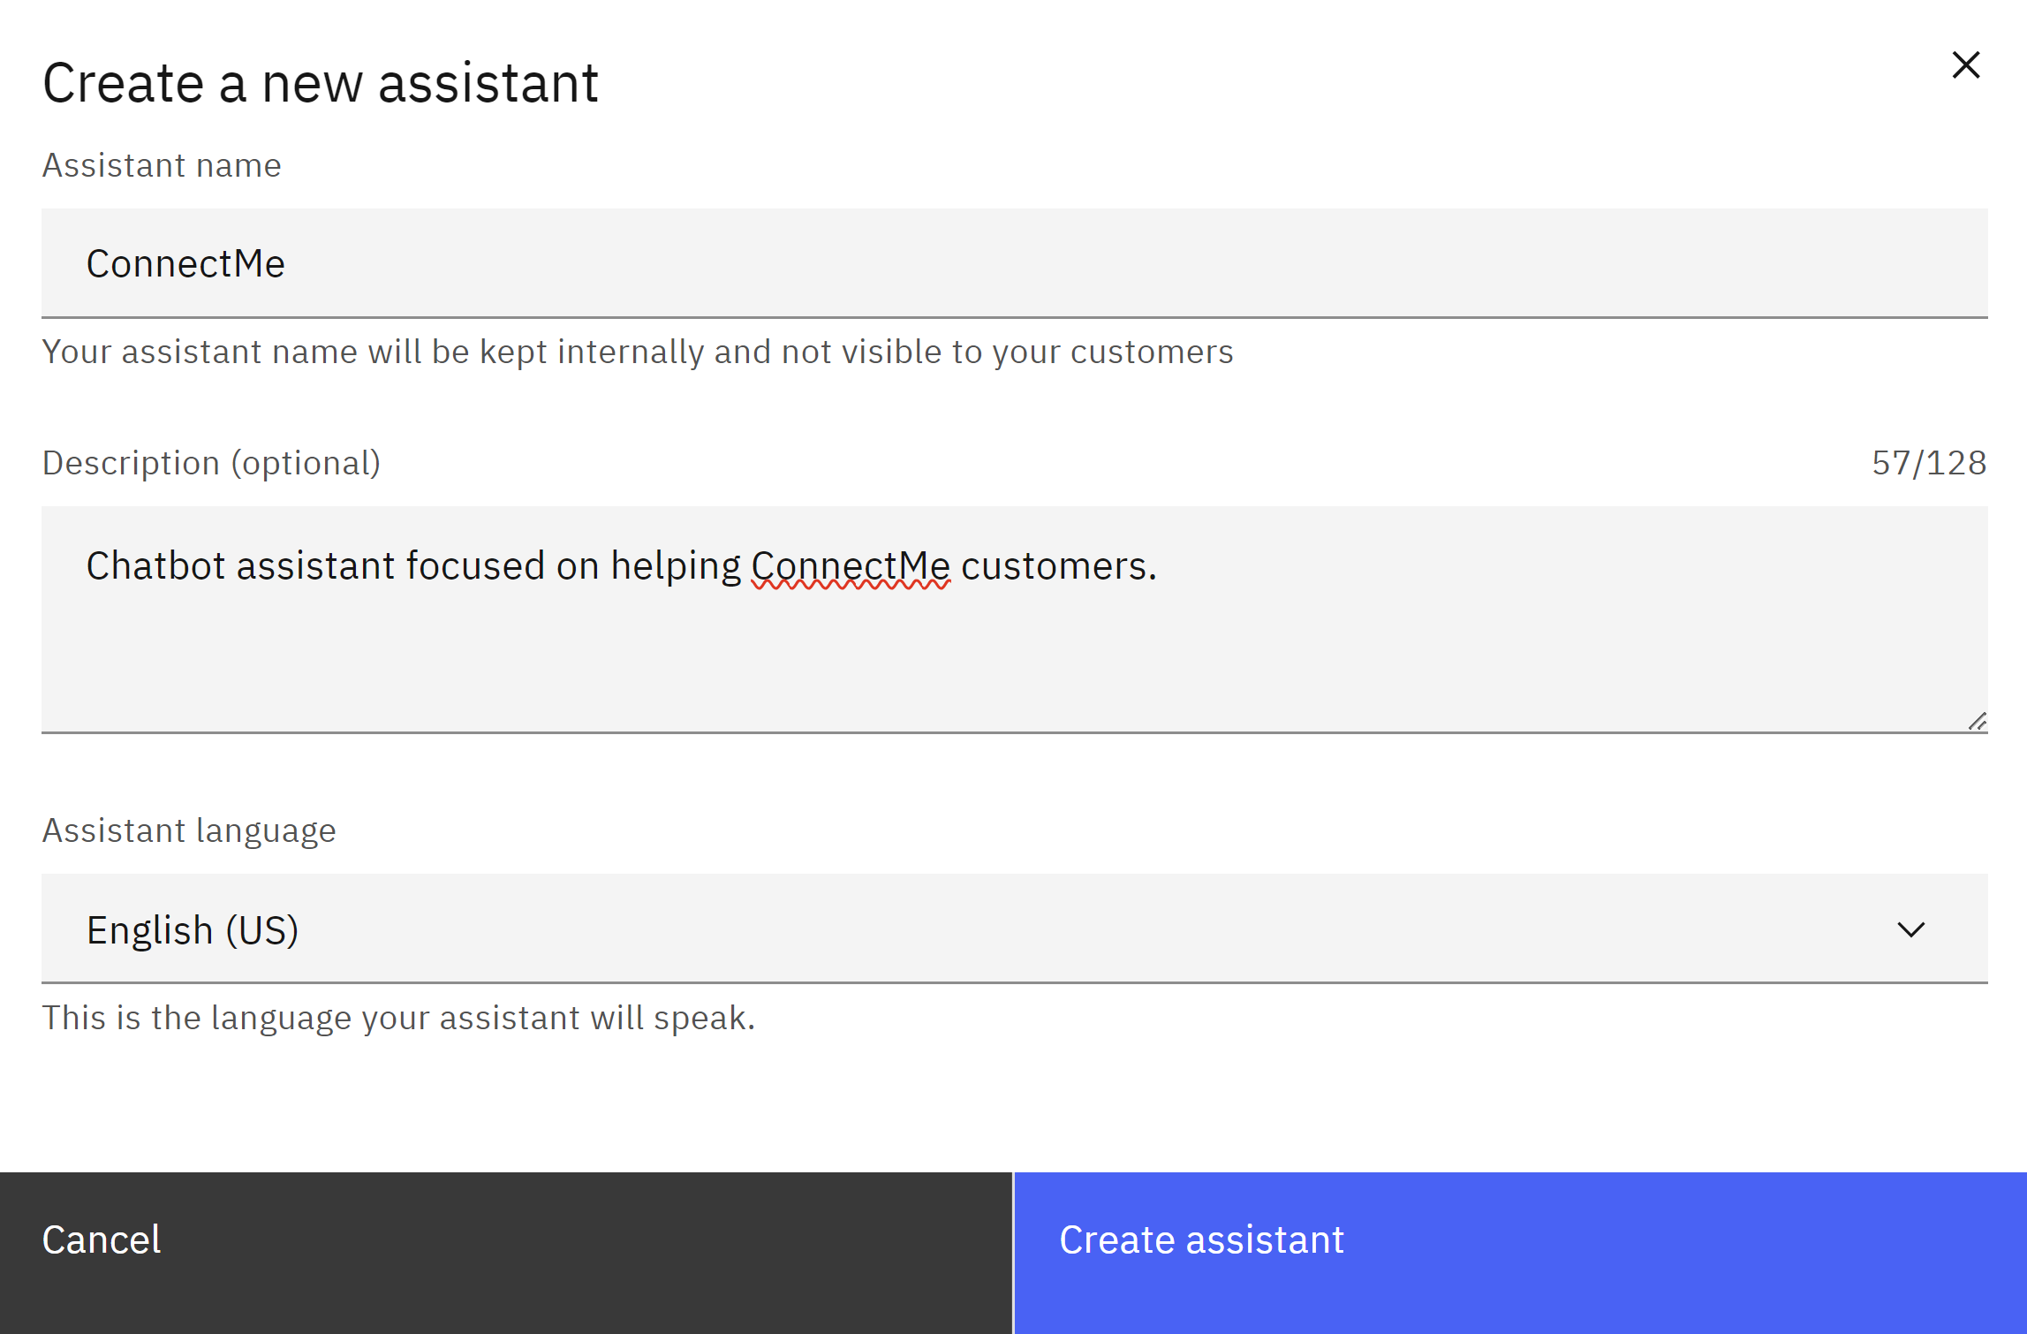
Create Watsonx Assistant
Video Demo: https://www.youtube.com/watch?v=JTcrllB82QE

Slide 16
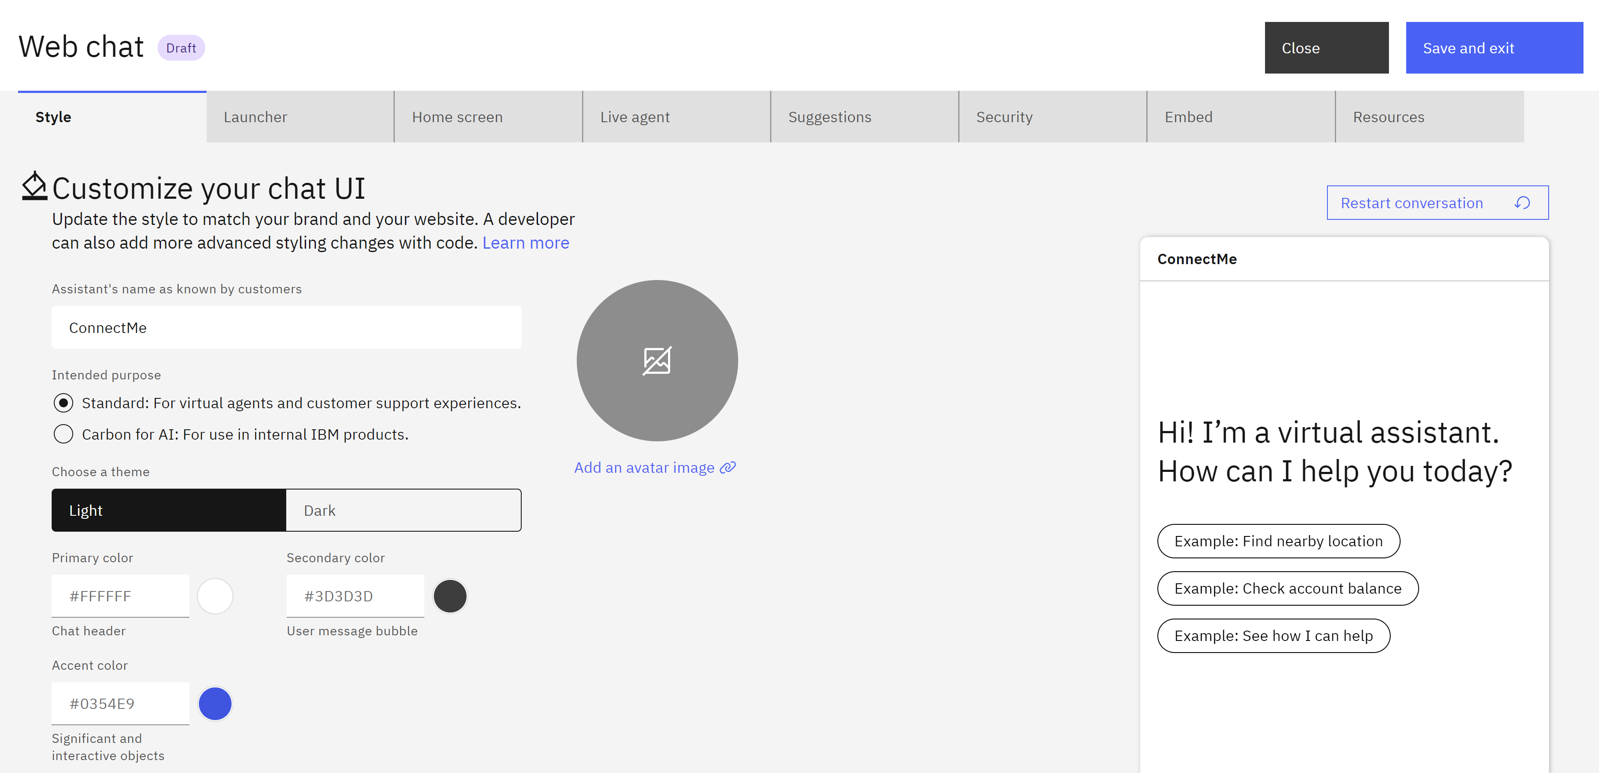
Customize Web Chat

Slide 17
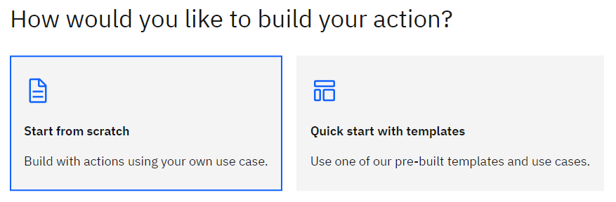
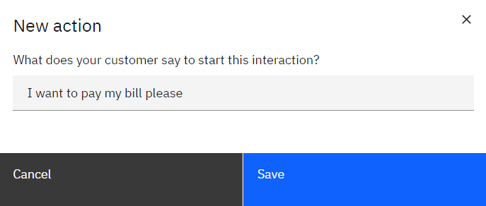
Create Action From Scratch and Set Initial Phrase

Slide 18
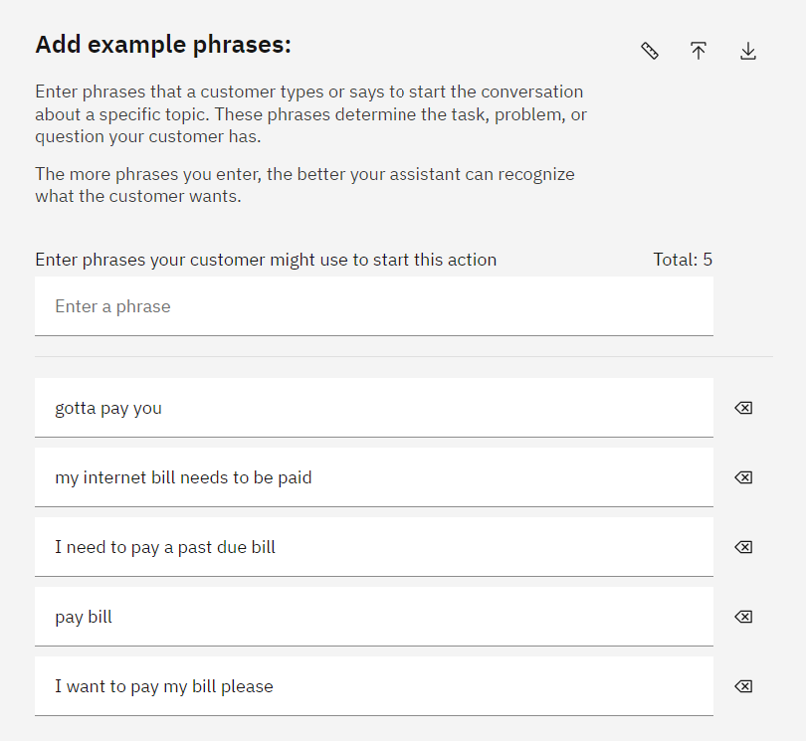
Add More Example Phrases
⭐

Slide 19
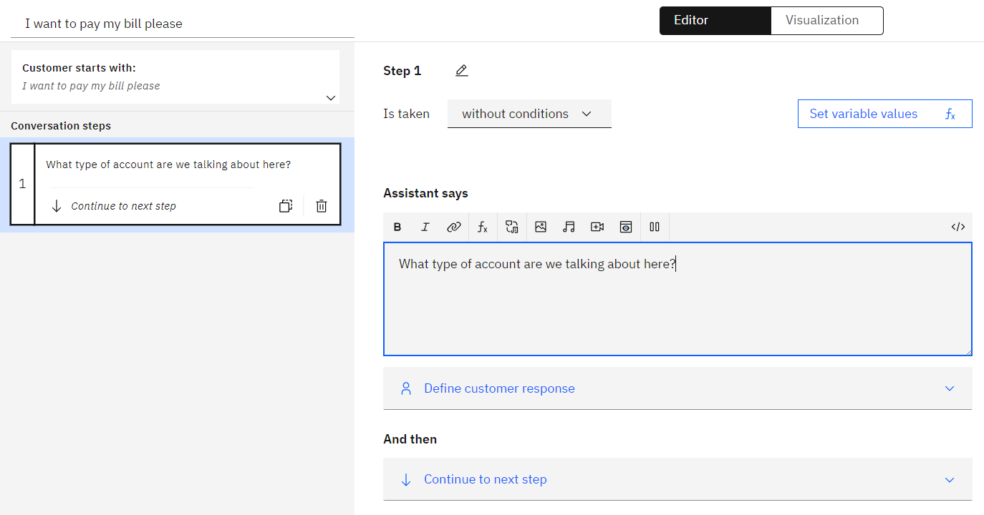
Create First Step

Slide 20
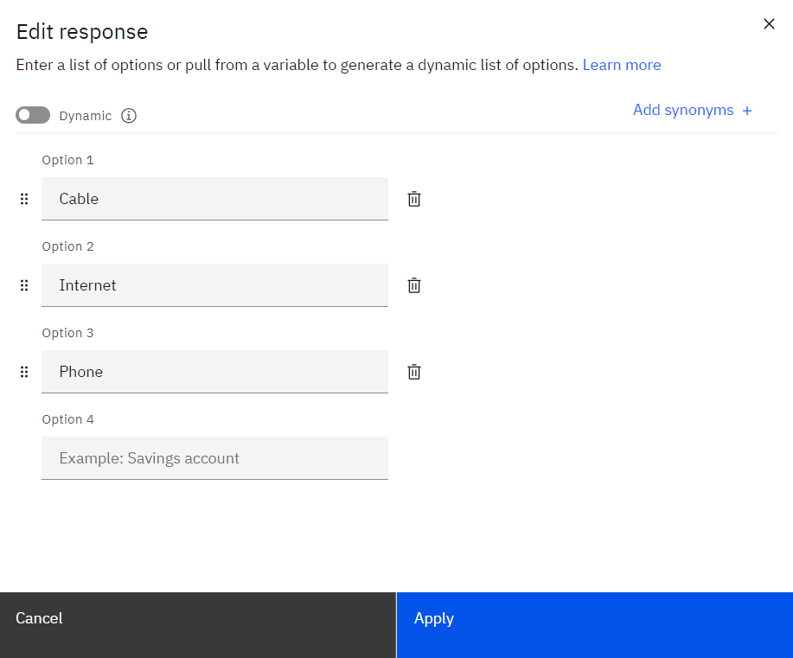
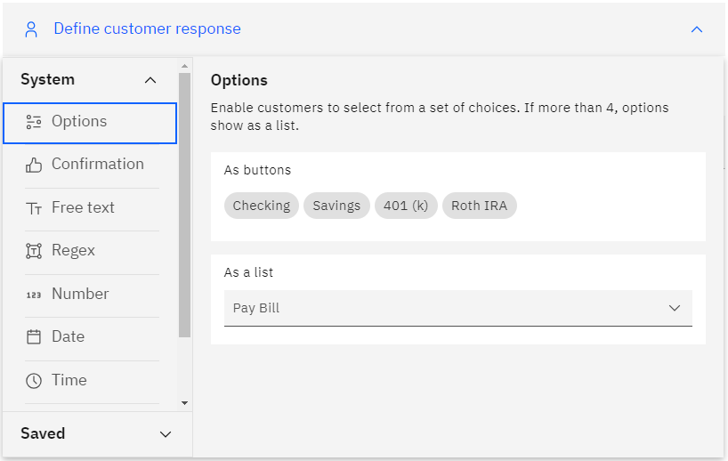
Add Custom Response Options

Slide 21
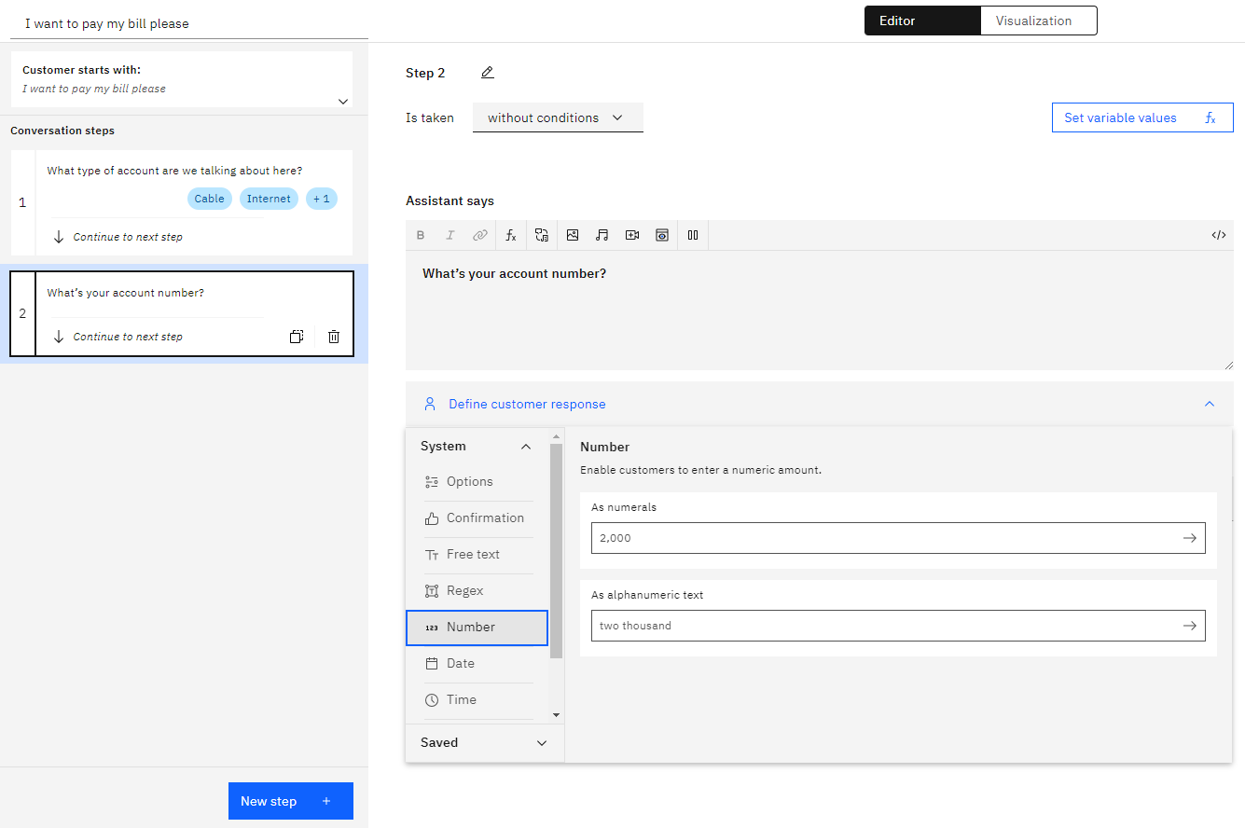
Create Another Clarification Step

Slide 22
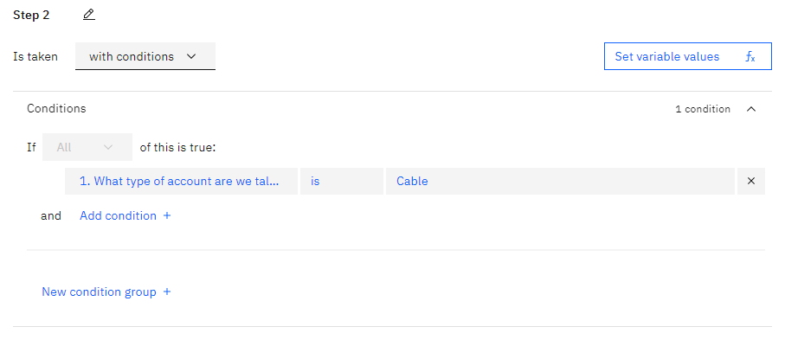
Add Condition

Slide 23
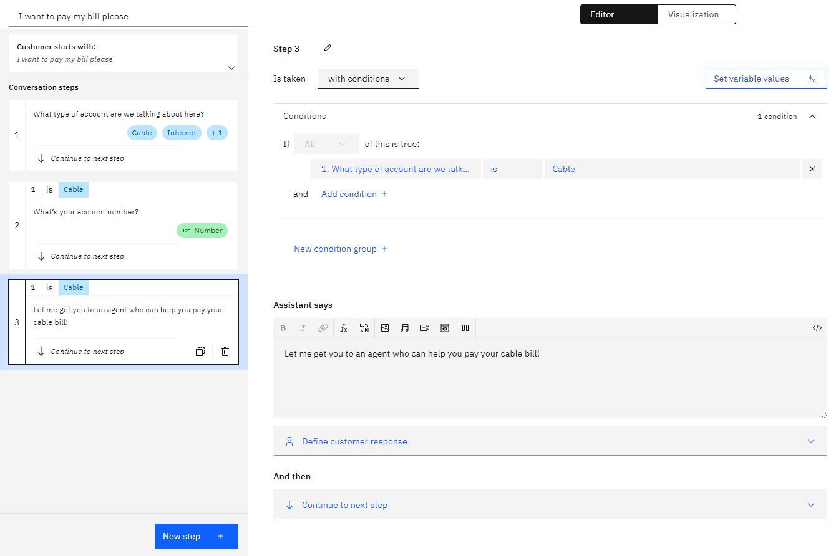
Create an Agent Handoff Step

Slide 24
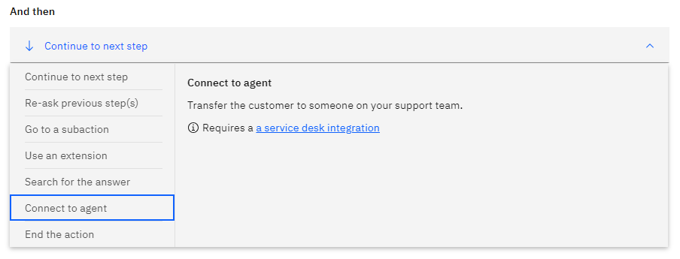
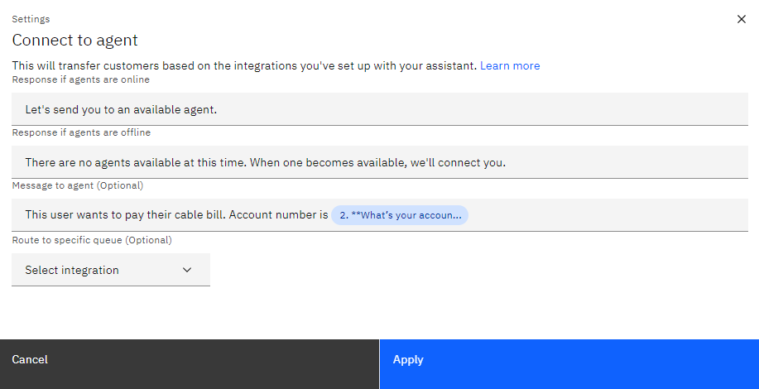
Connect to Agent

Slide 25
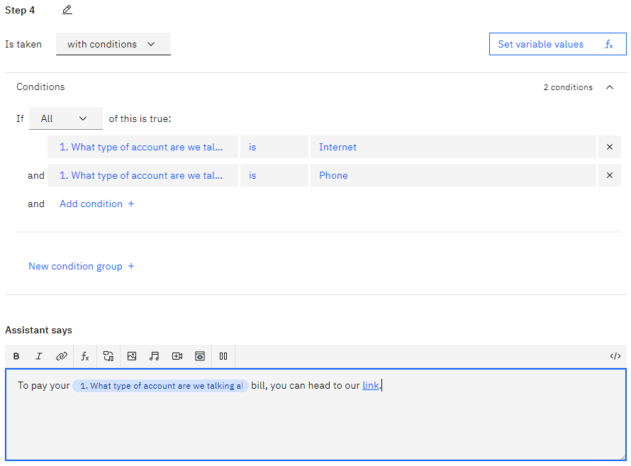
Create Final Response Step

Slide 26
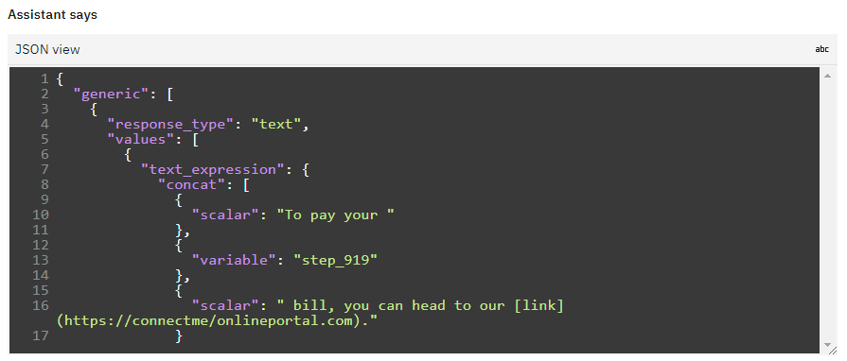
Edit Response in JSON View

Slide 27
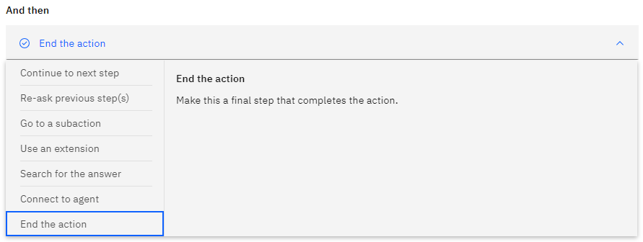
End the Action

Slide 28
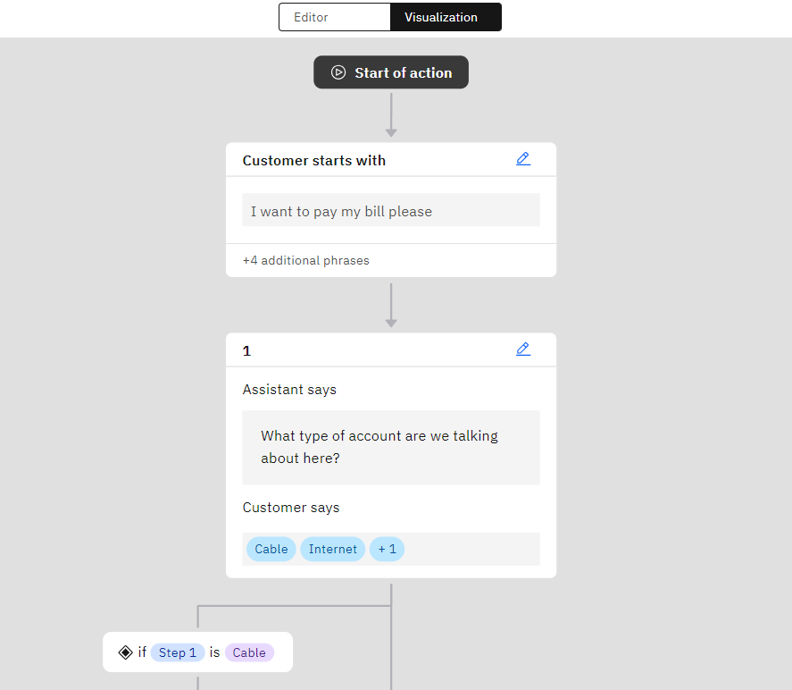
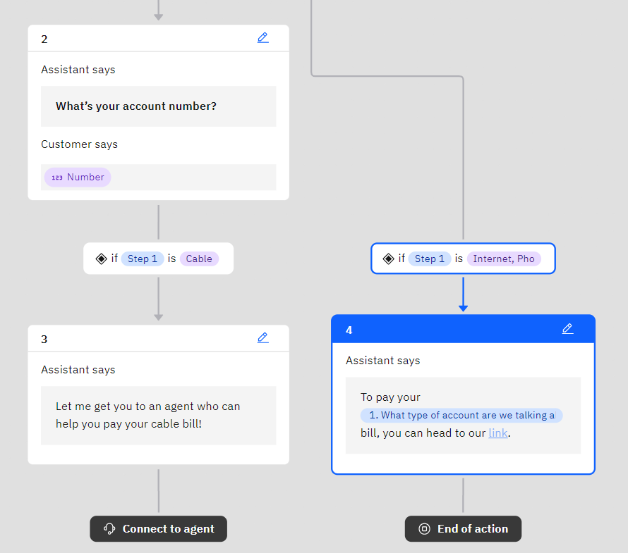
Use Visualization Tool

Slide 29
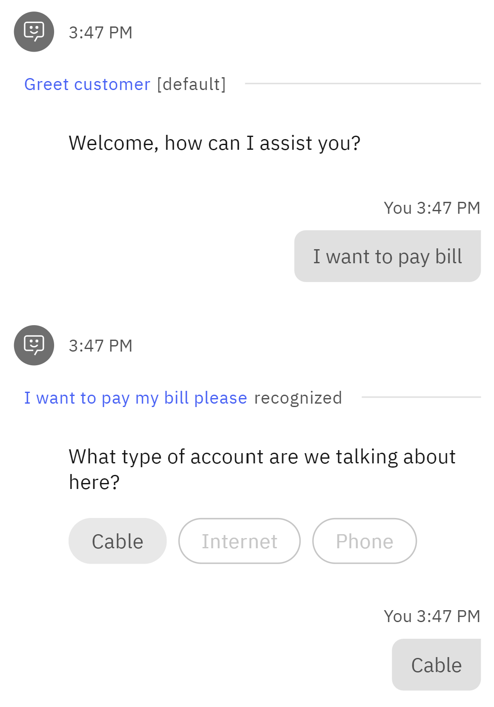
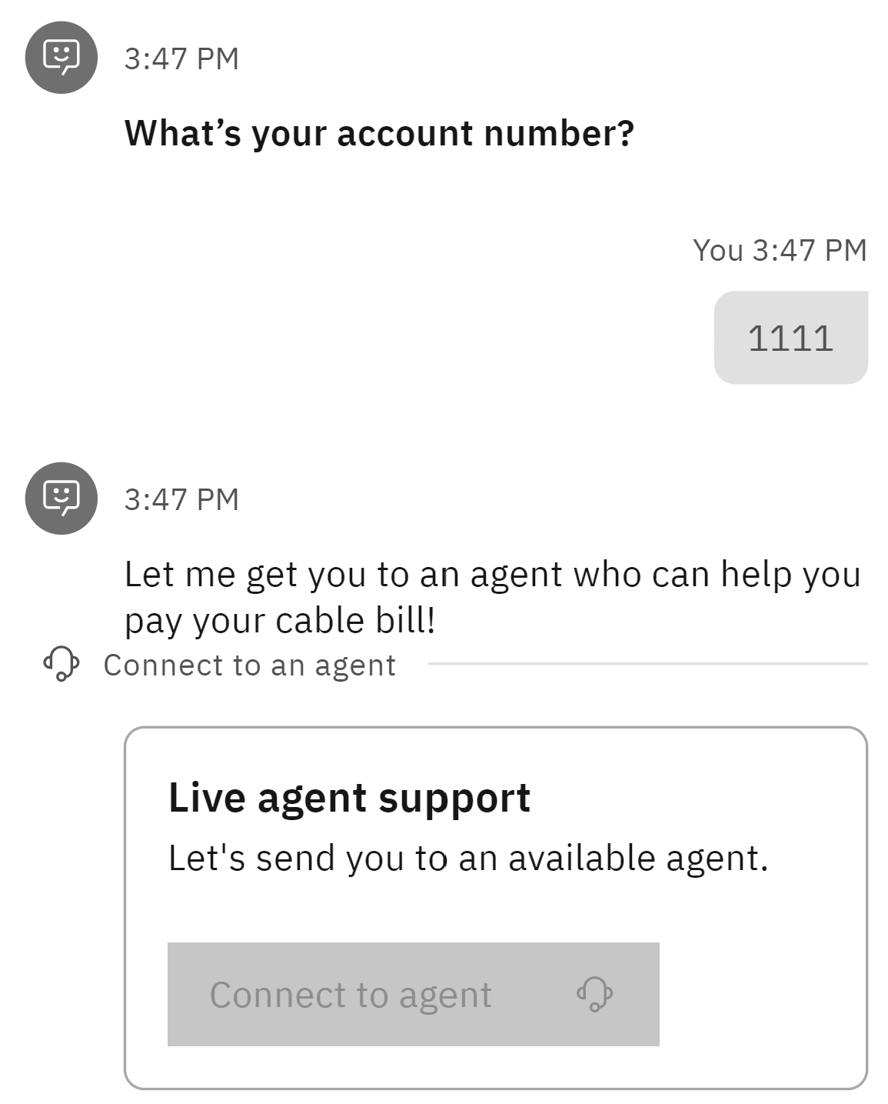
Preview Your Action

Slide 30
Integrate with Db2

Slide 31
Have you ever used Mapepire?
Choose 1:
Yes, mapepire-java
Yes, mapepire-python
Yes, mapepire-js
Yes, more than one of the above SDKs
No, but heard of it
No, never heard of it

Slide 32
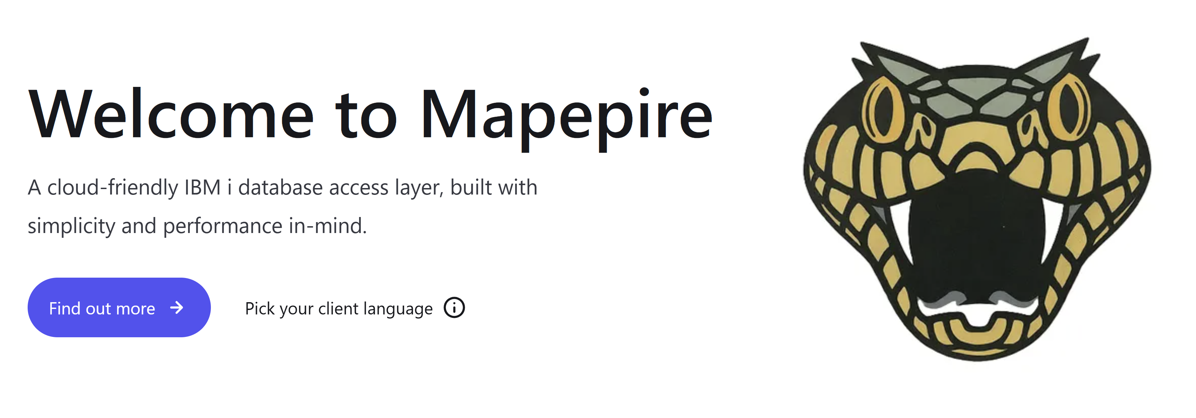

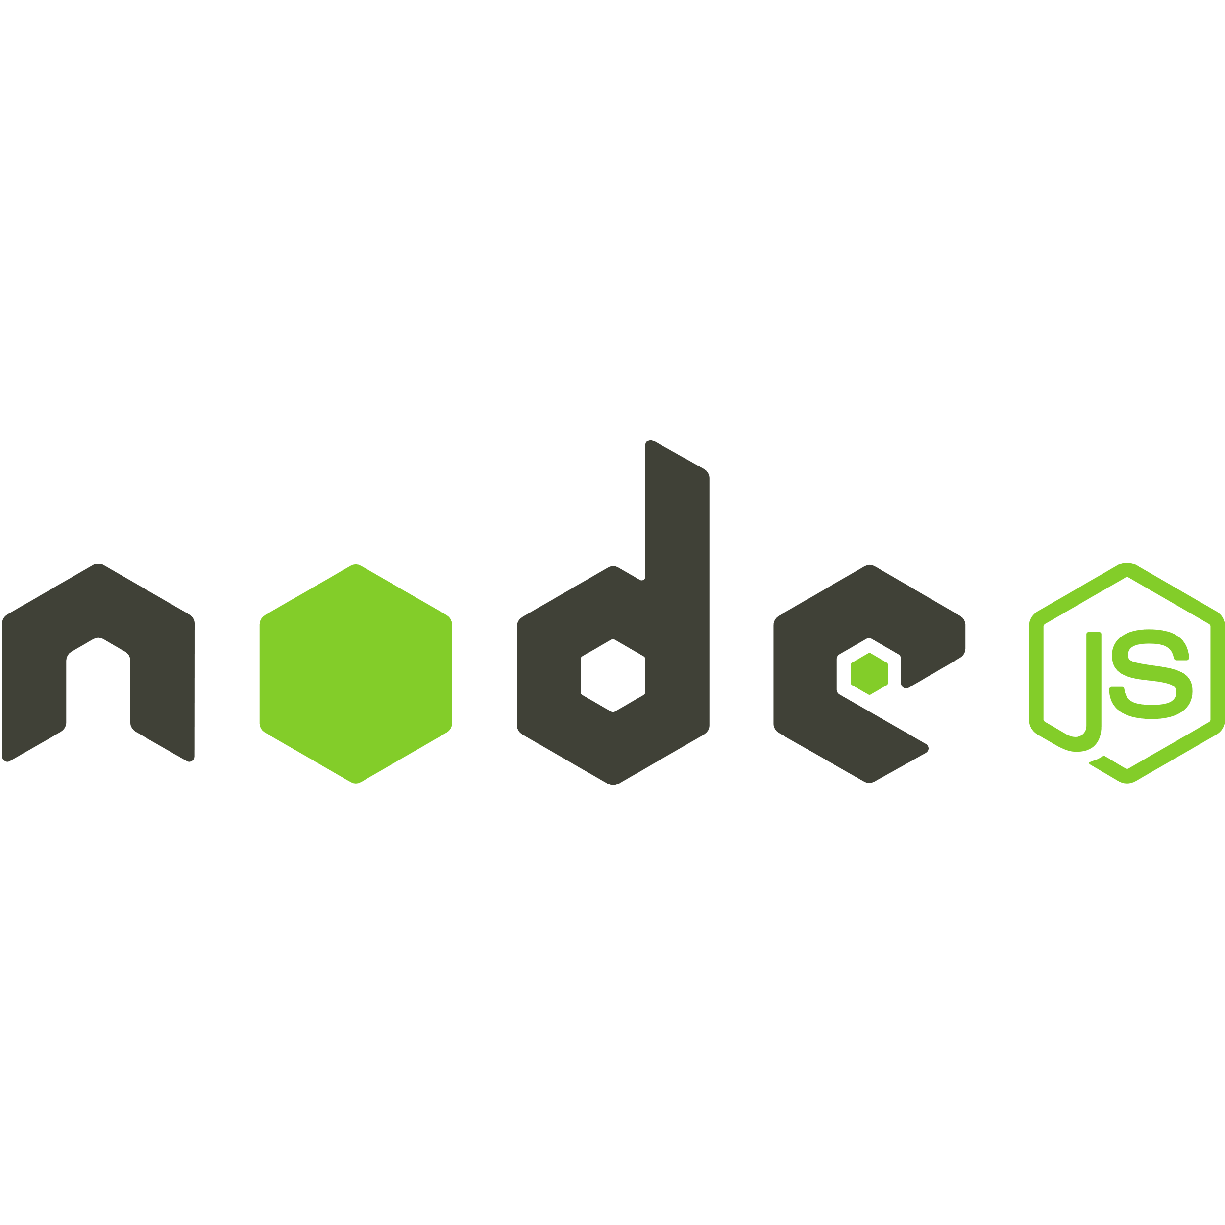
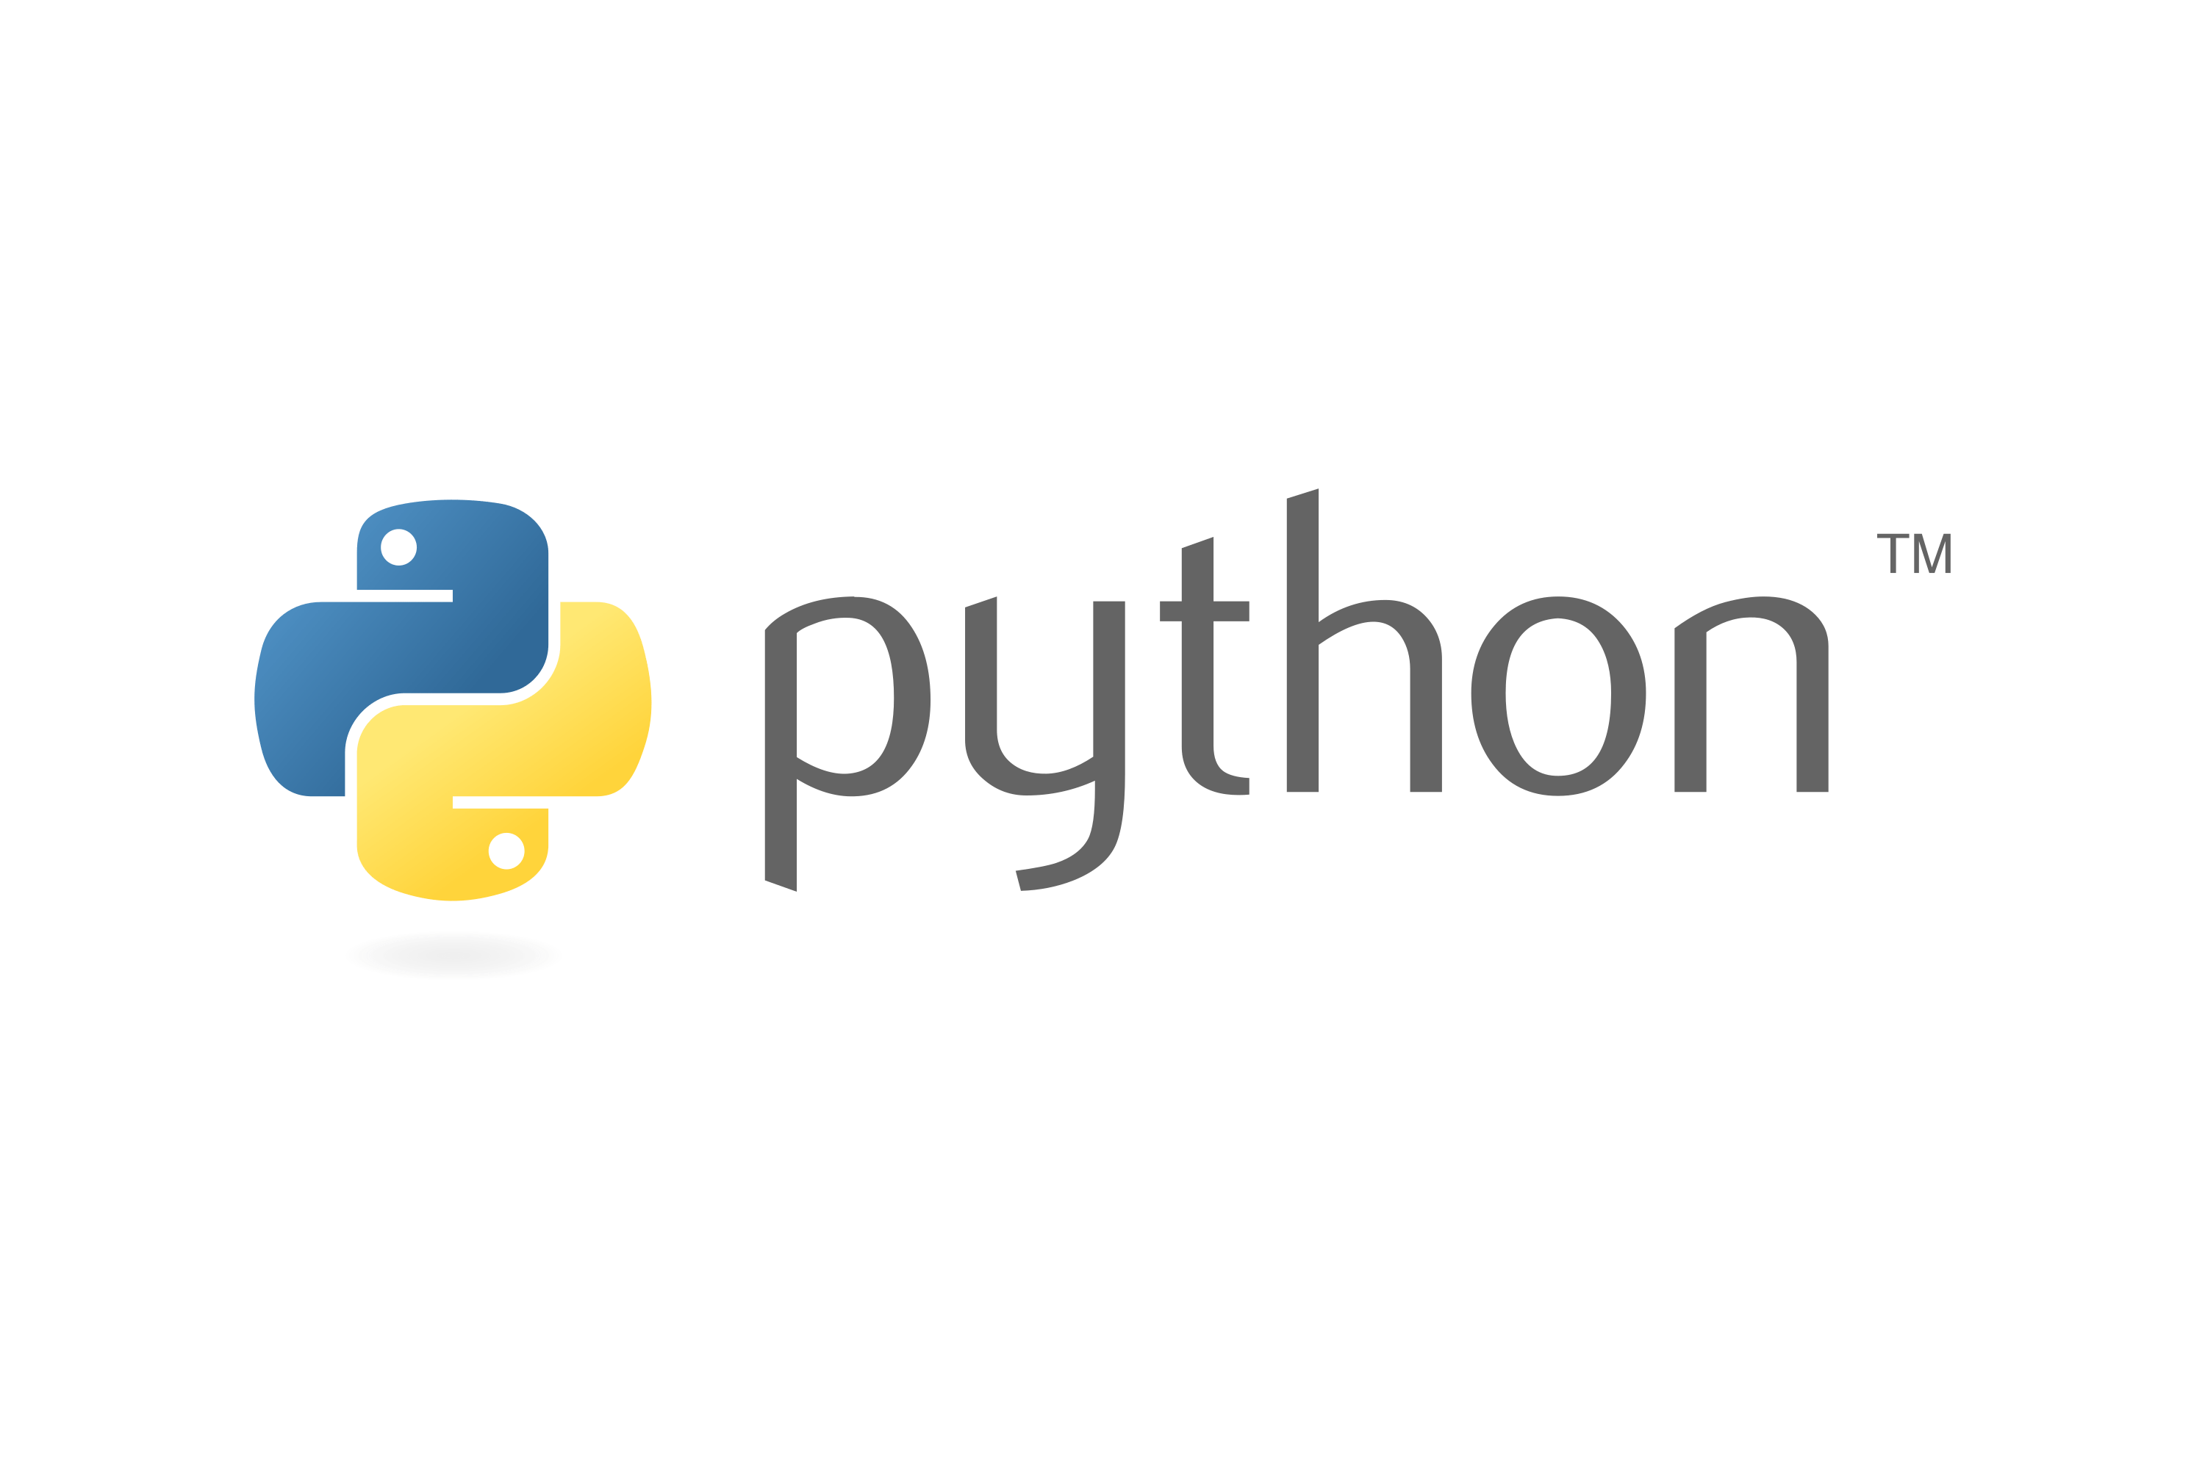
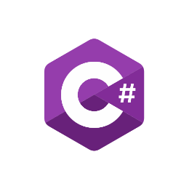

What is Mapepire?
Super easy to use way to access Db2 for i from any application

Slide 33
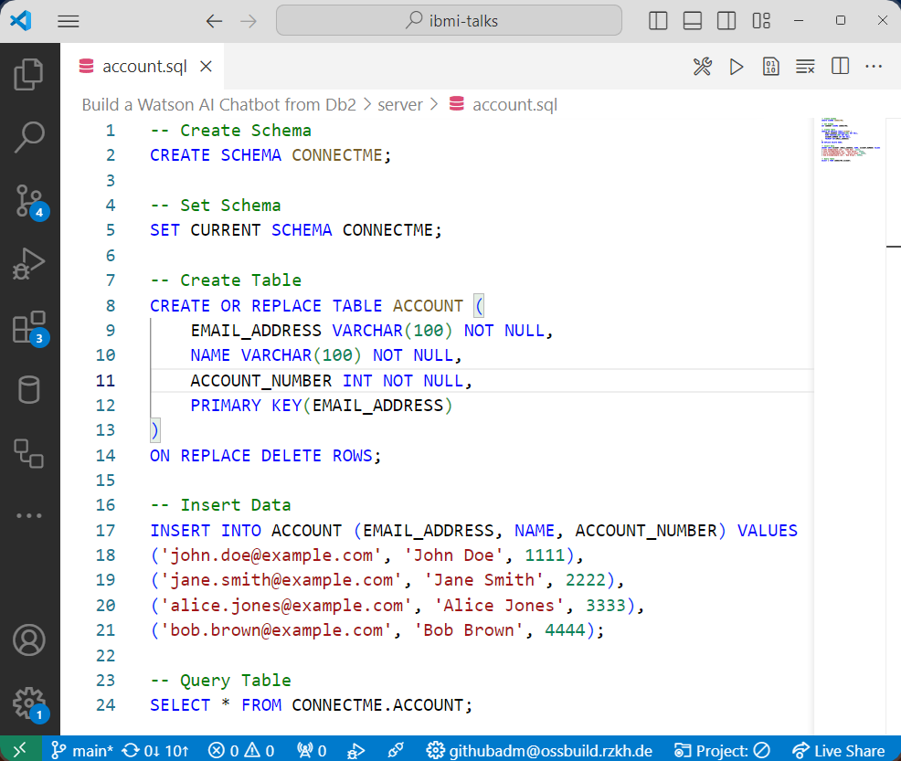
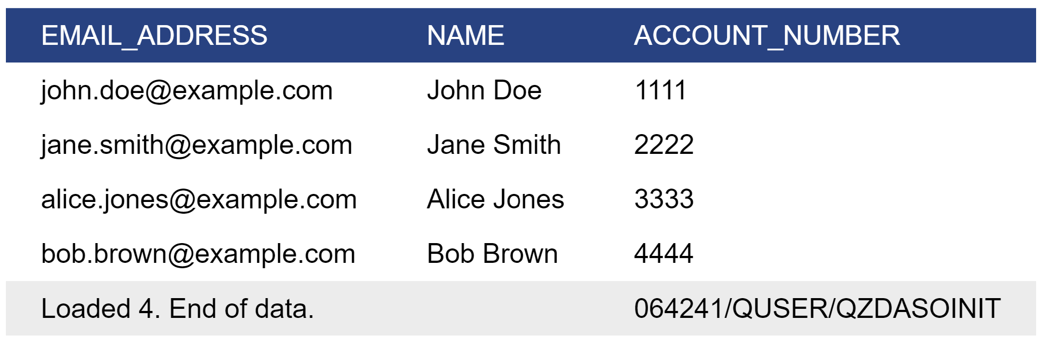
Create Table
Video Demo: https://www.youtube.com/watch?v=RmDchLsPc18

Slide 34
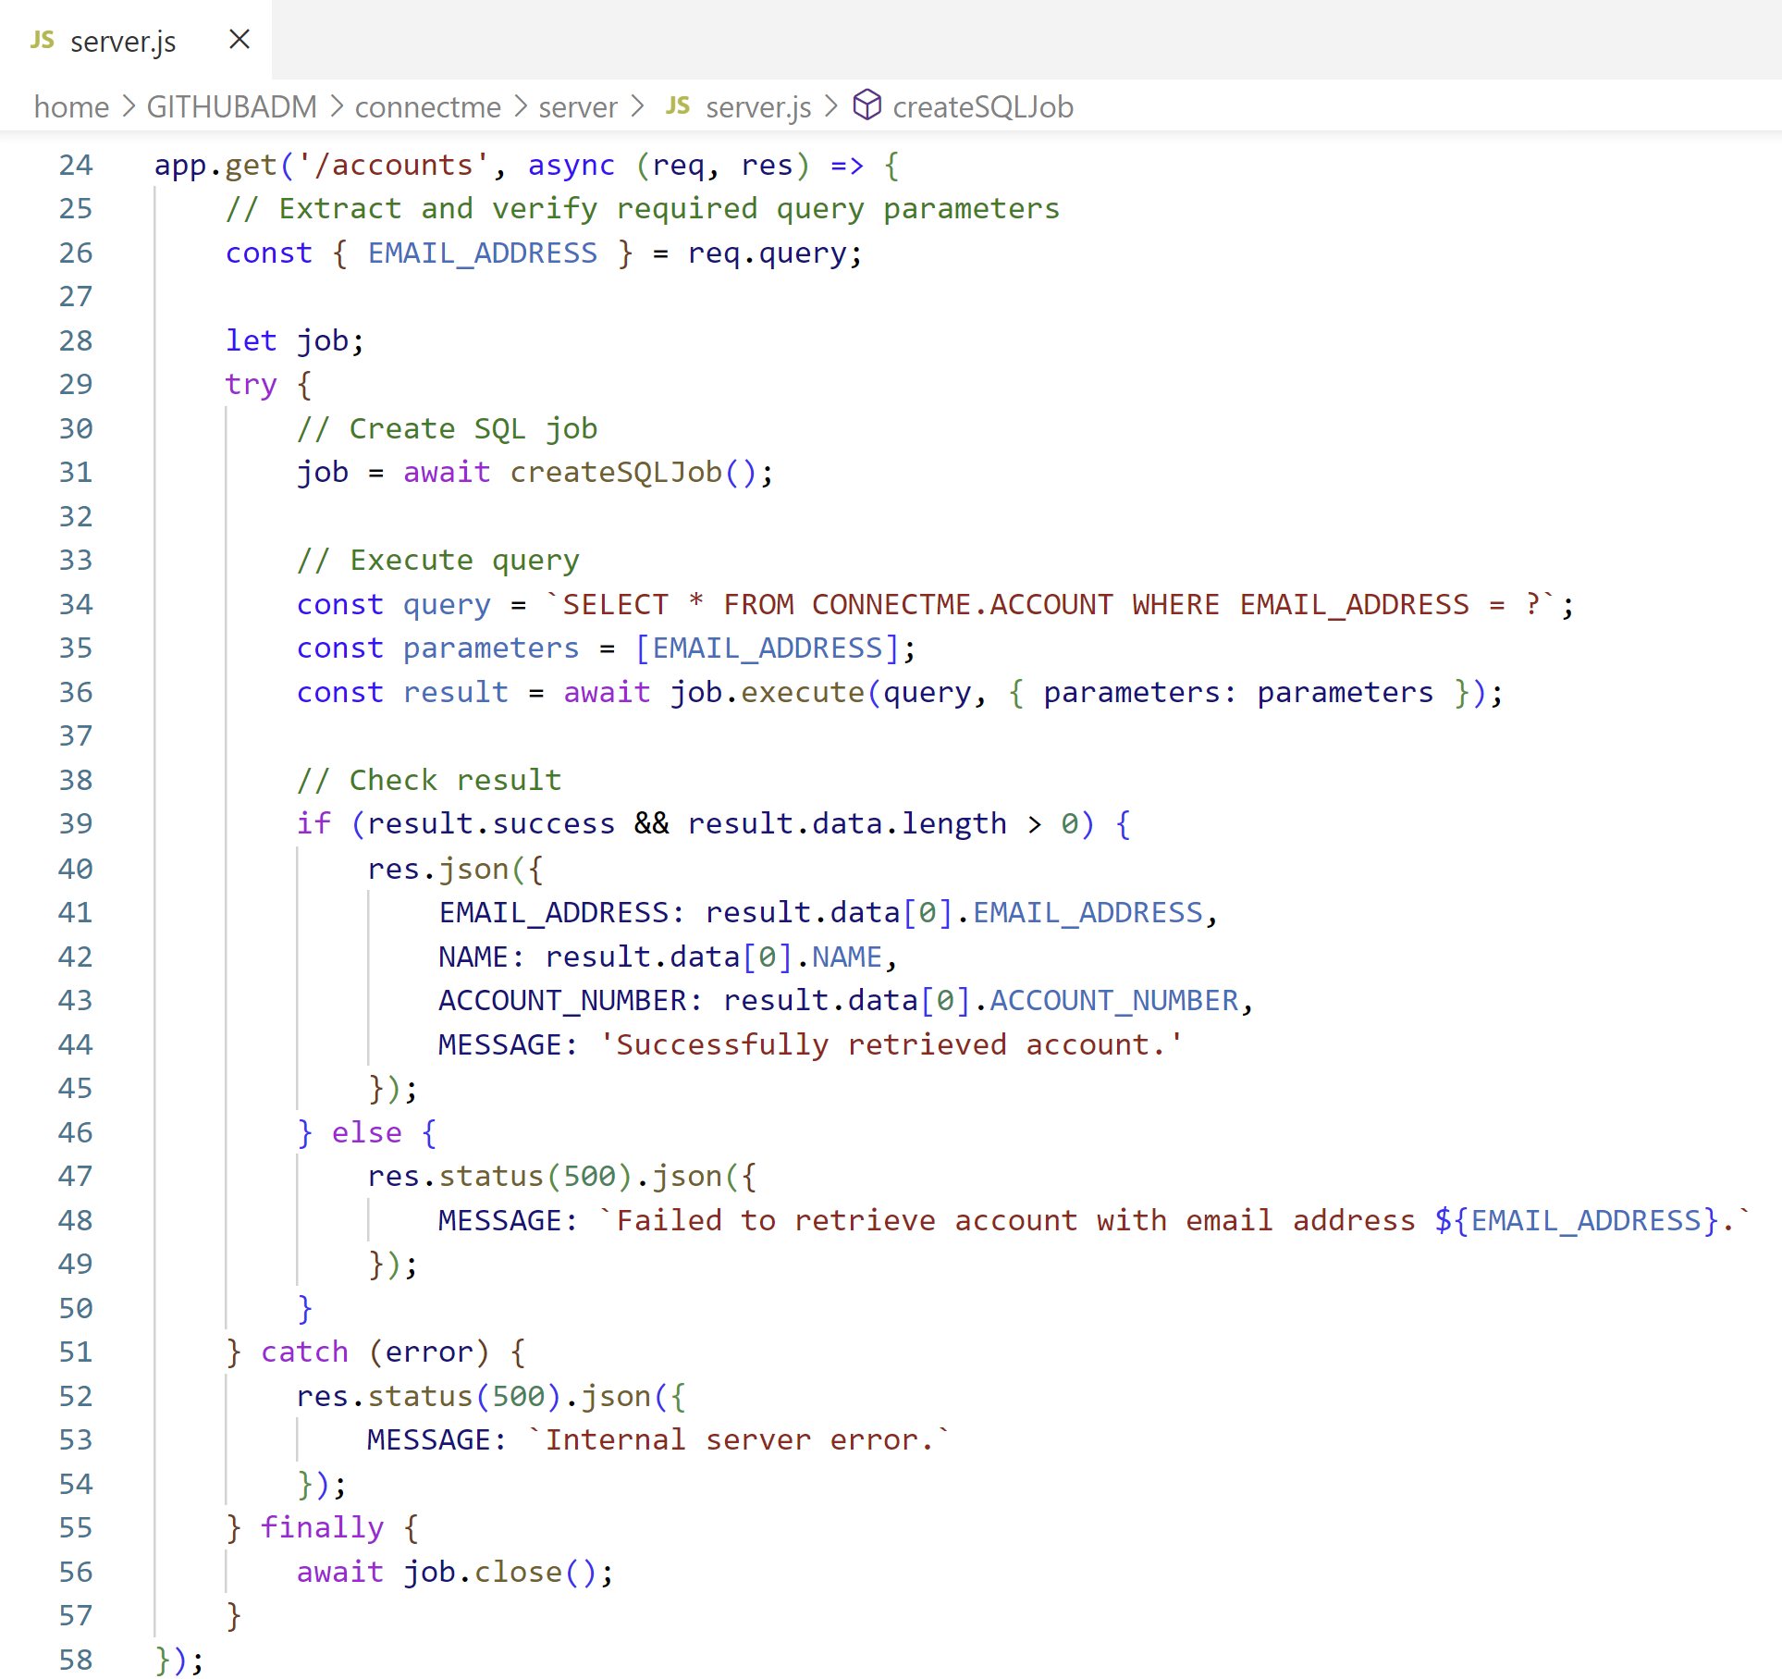
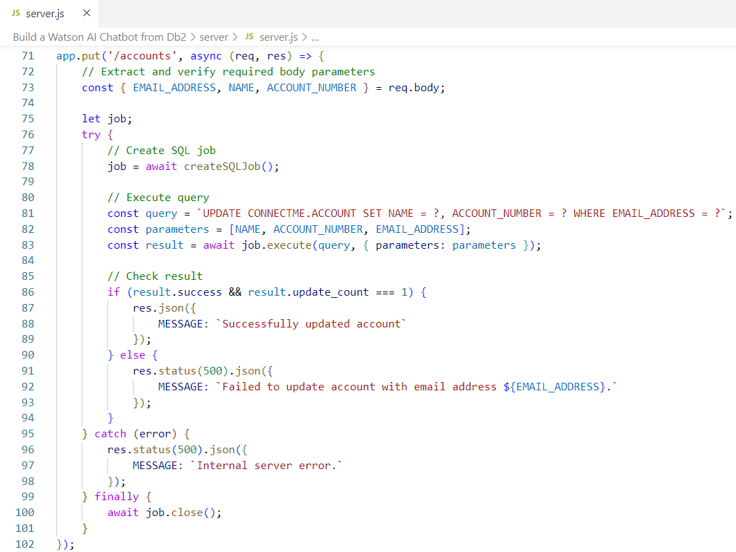
Create REST Server
👨🏻‍💻Server Source Code: server.js
SELECT * FROM CONNECTME.ACCOUNT WHERE EMAIL_ADDRESS = ?
UPDATE CONNECTME.ACCOUNT SET NAME = ?, ACCOUNT_NUMBER = ? WHERE EMAIL_ADDRESS = ?

Slide 35
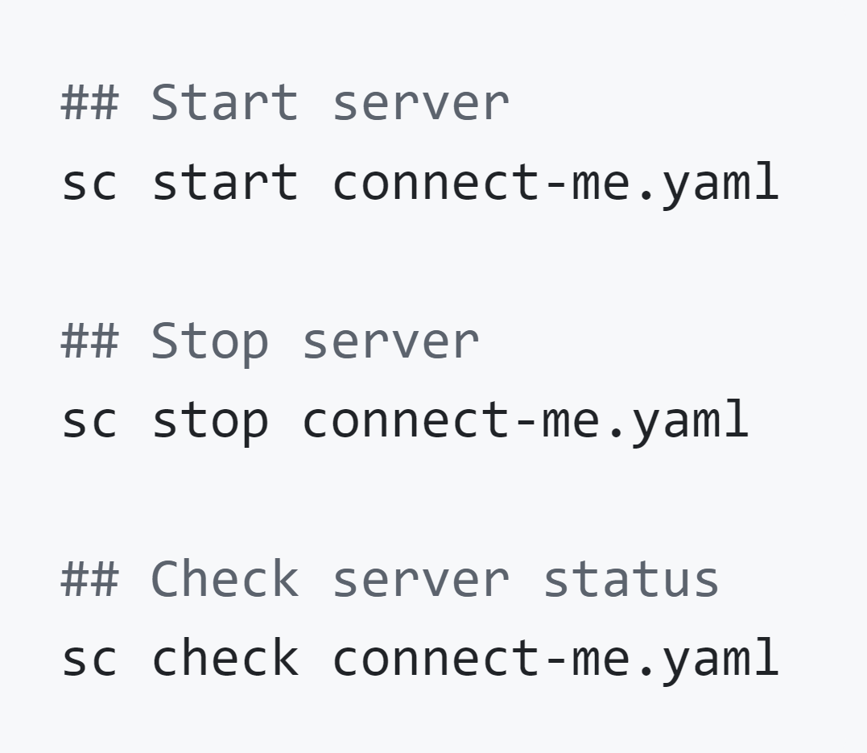
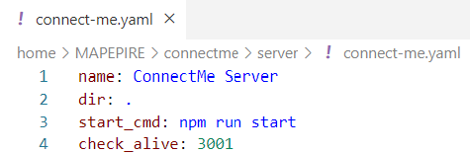
Create Service Commander Definition to Start Server
Service Commander A utility for managing services and applications running on IBM i

Slide 36
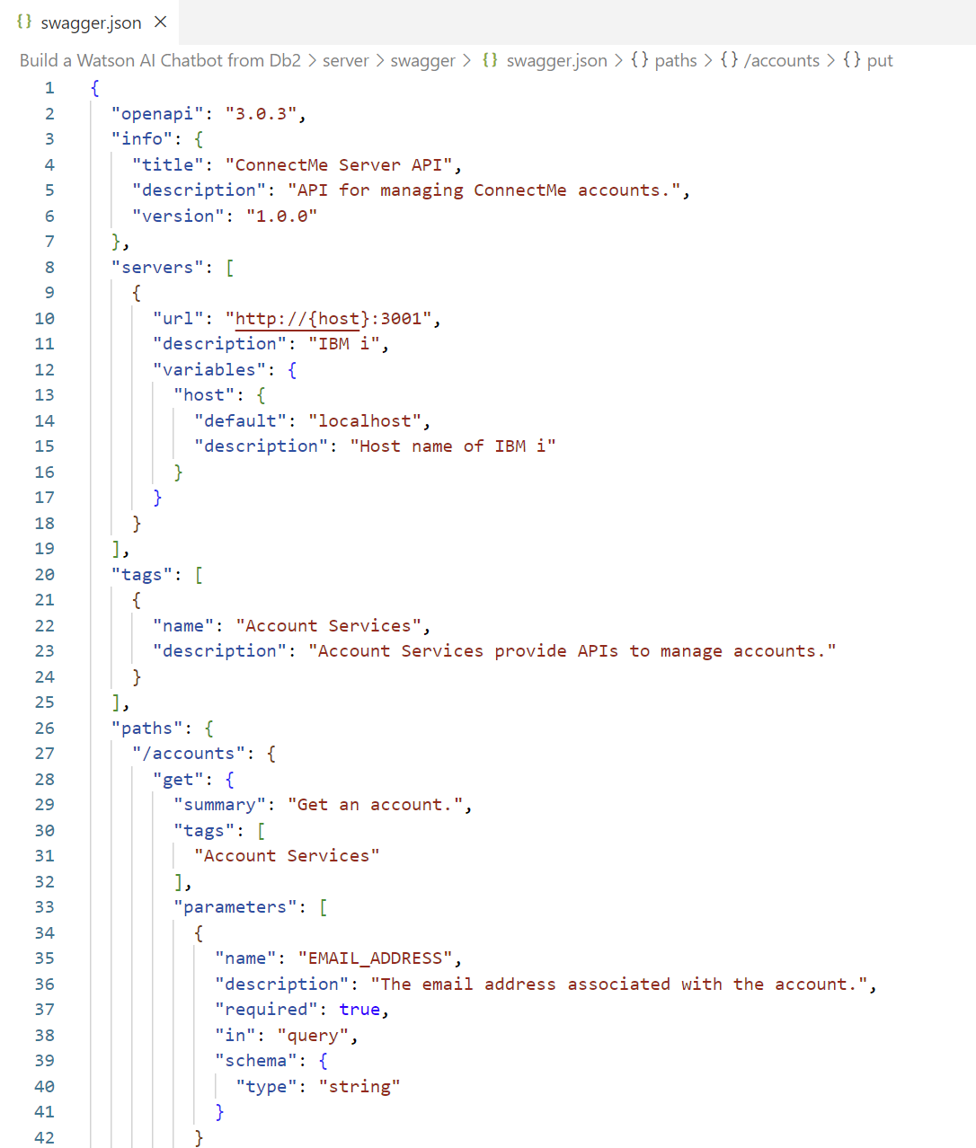
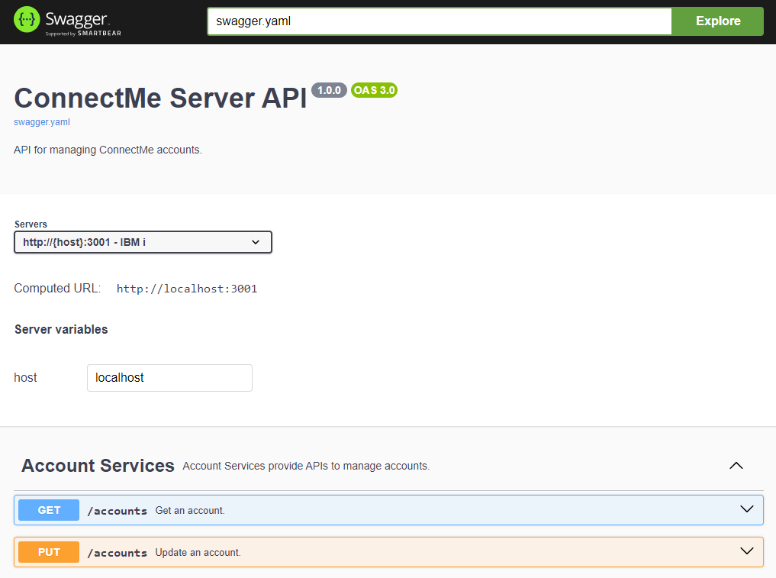
Create OpenAPI Specification (in JSON format)

Slide 37
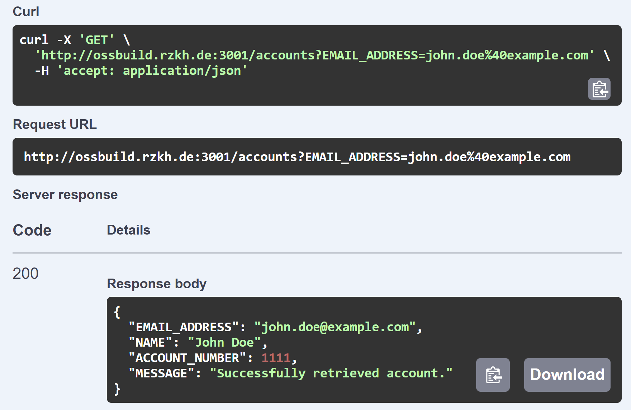
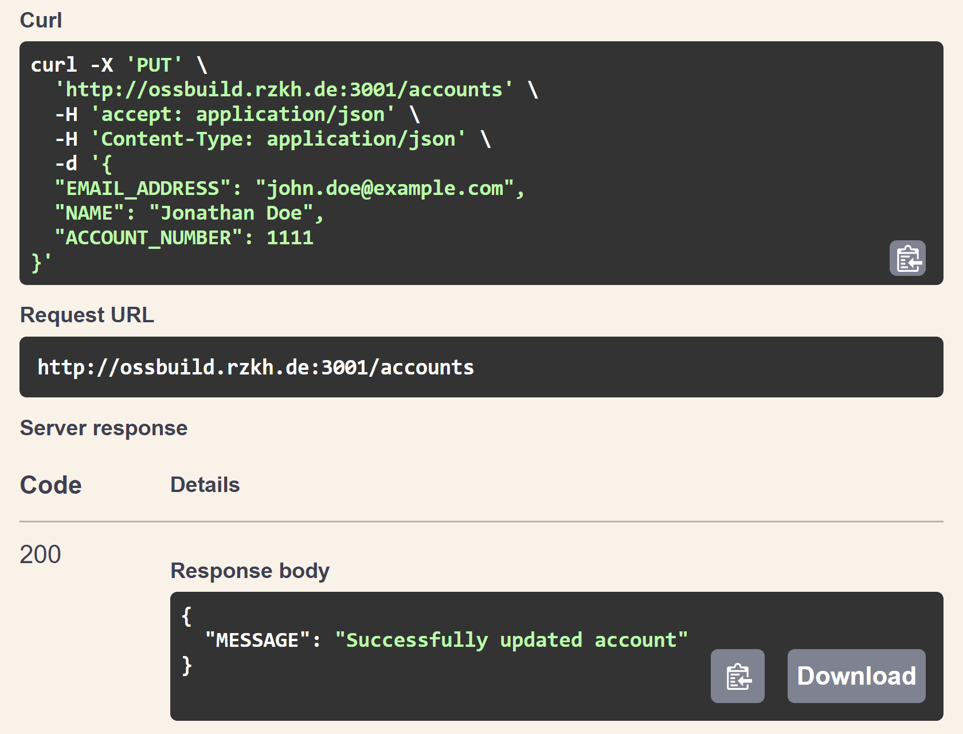
Test OpenAPI Specification

Slide 38
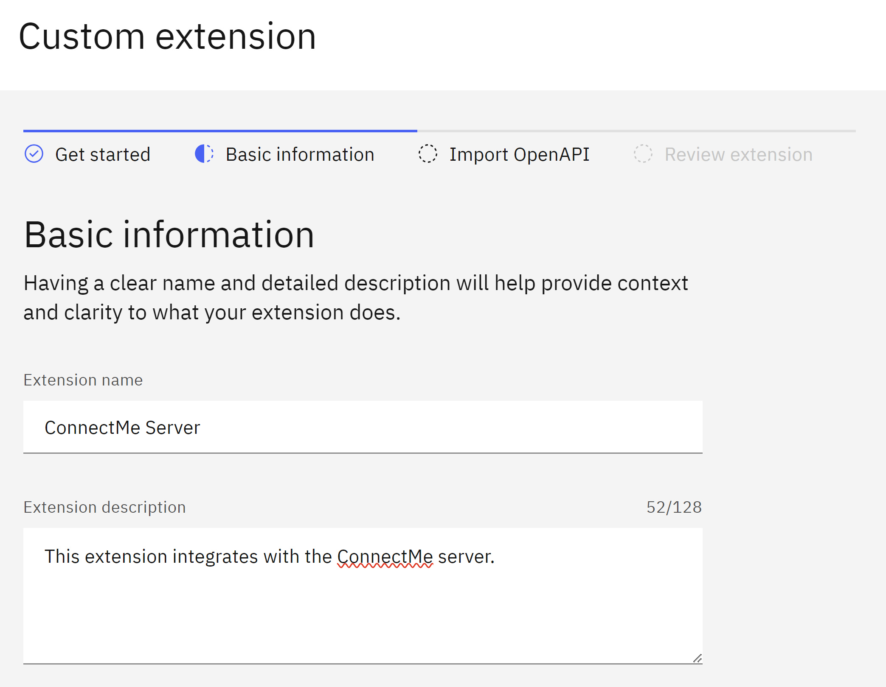
Build Custom Extension

Slide 39
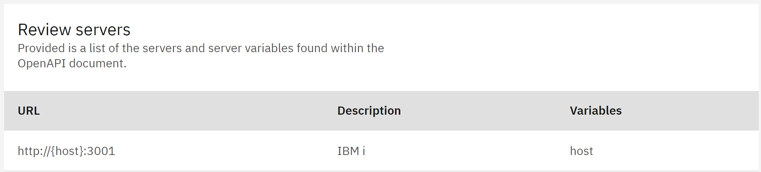
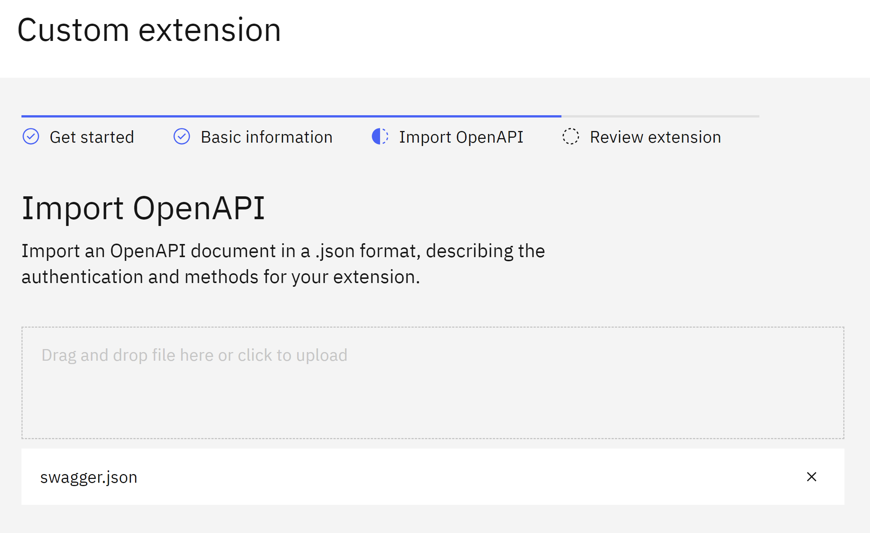
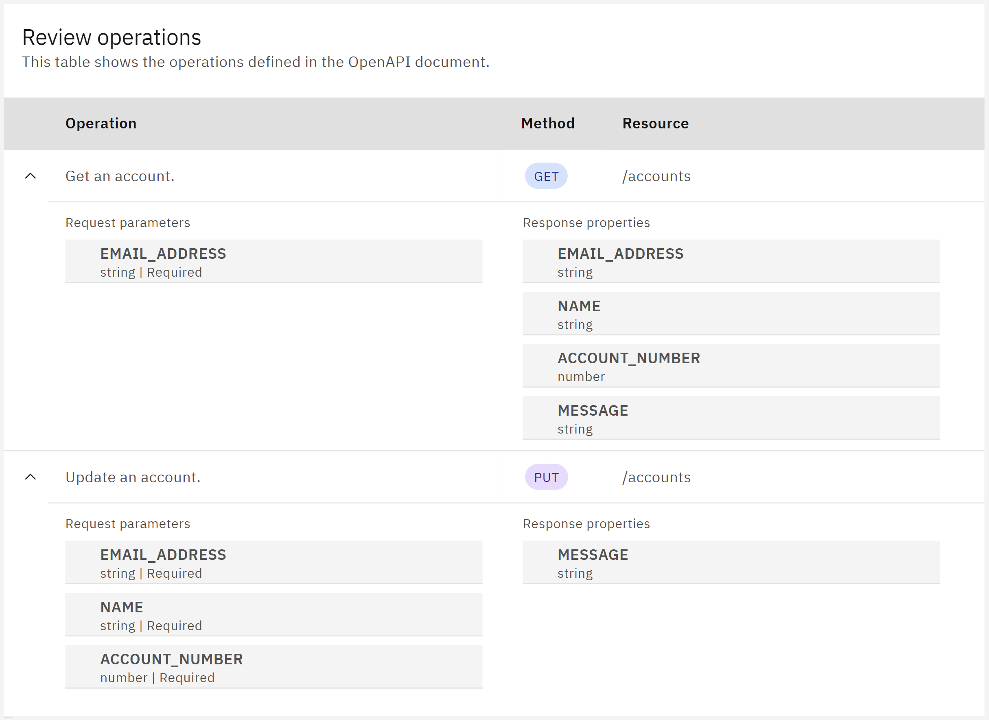
Import OpenAPI Specification

Slide 40
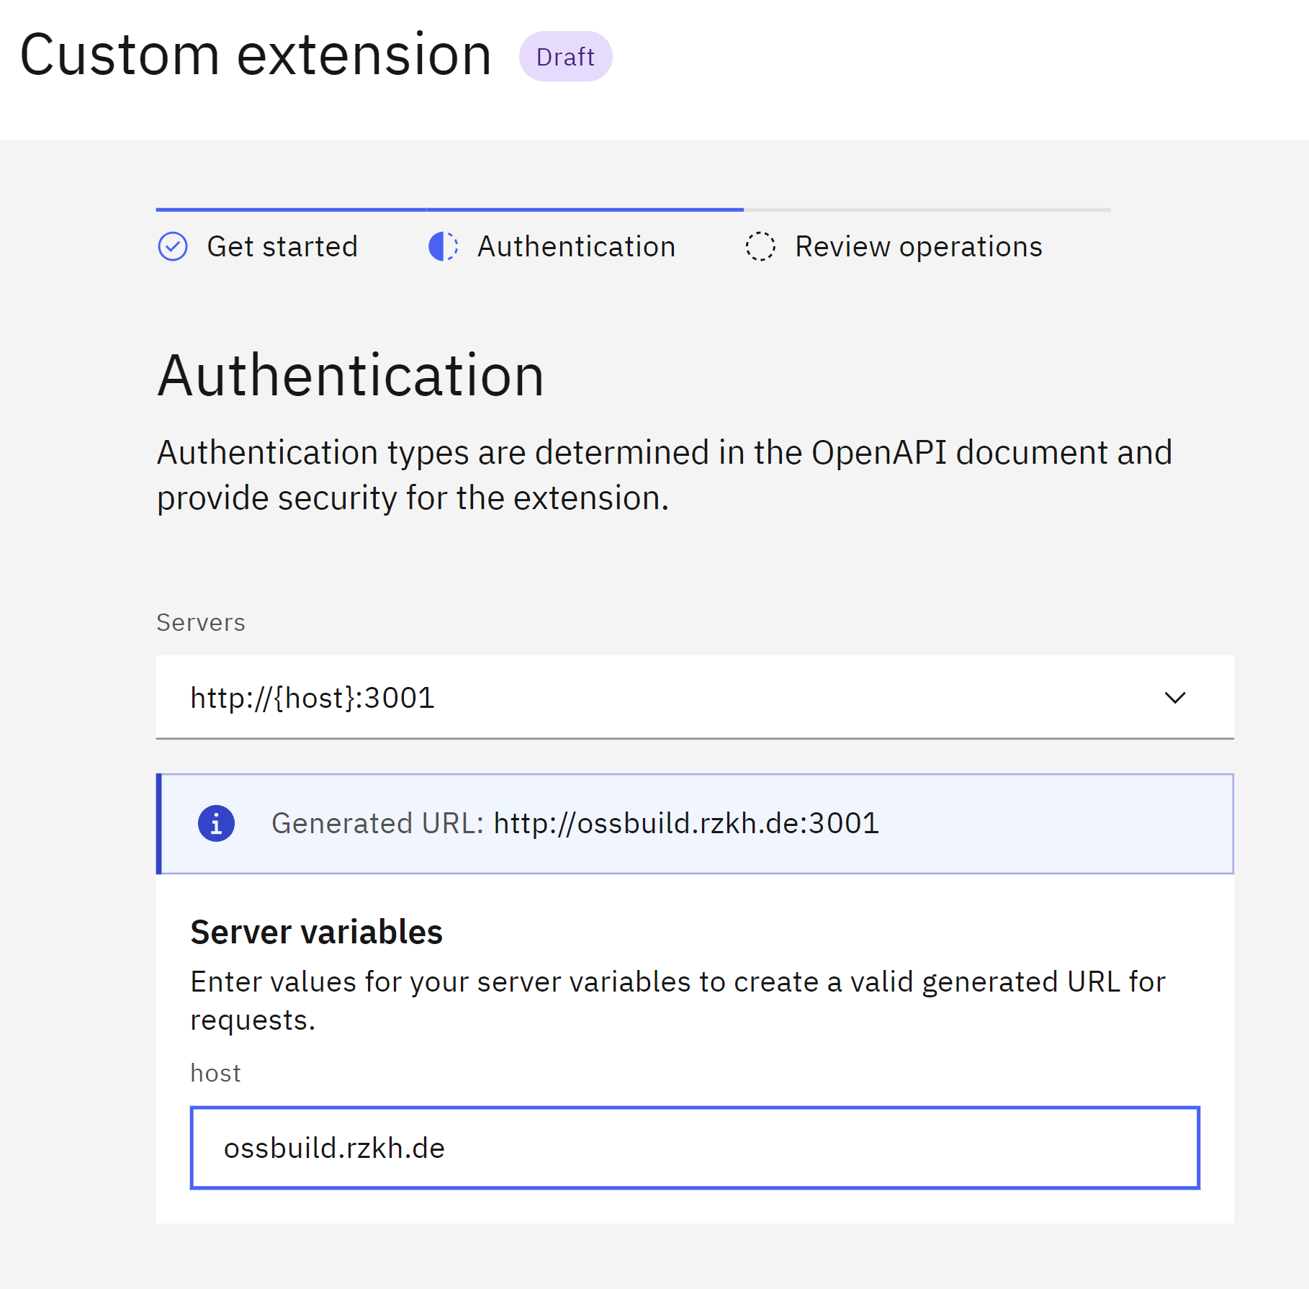
Add Extension to Watsonx Assistant

Slide 41
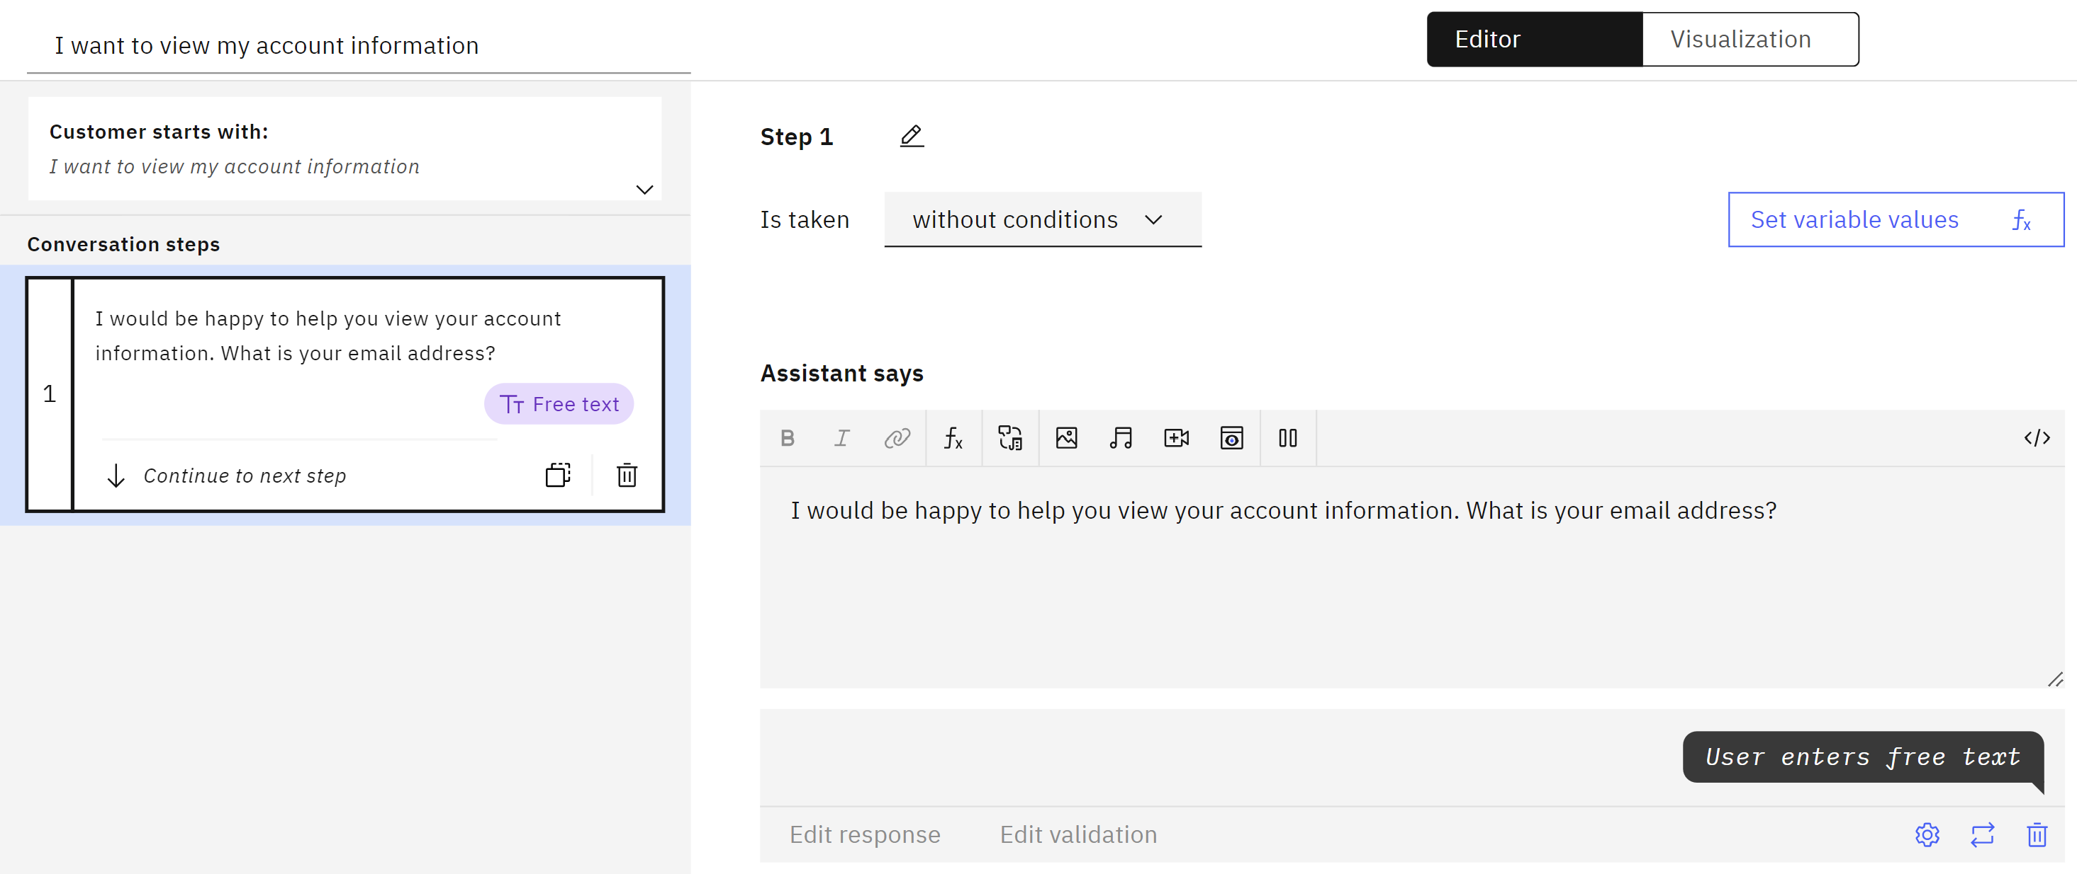
Create New Action with Initial Step

Slide 42


Create Step with Extension

Slide 43


Create Success and Failure Steps
Extension Success
Extension Failure

Slide 44


Preview Your Action

Slide 45


Duplicate Action and Update Phrase + Initial Step

Slide 46

Create Clarification Step

Slide 47


Create Step with Extension

Slide 48

Create Final Step

Slide 49



Preview Your Action

Slide 50
Next Steps

Slide 51

Add More Actions with Templates

Slide 52

Adjust Default Actions

Slide 53



Adjust Global Settings
Clarifying Questions
Show options when multiple actions seem to match what the customer wants
Change Conversation Topics Switch to other actions when customers ask about other topics
Intelligent Information Gathering The assistant retrieves and uses prior inputs to streamline the conversation

Slide 54



Search Integration with Watson Discovery
Search Integration Extend the scope of what your assistant can answer by searching documents and websites.

Slide 55
Takeaways
Building a chatbot with Watsonx Assistant is easy!
01
Planning is critical and building can be an incremental process.
02
Integrating your chatbot with Db2 is as simple as creating a REST server with Mapepire.
03

Slide 56
Any Questions?

Slide 58
For more information IBM Sites:
IBM i Home Page | https://www.ibm.com/it-infrastructure/power/os/ibm-i
IBM Strategy Whitepaper | https://www.ibm.com/it-infrastructure/us-en/resources/power/i-strategy-roadmap/
IBM Client Success | https://www.ibm.com/it-infrastructure/us-en/resources/power/ibm-i-customer-stories/
Support Life Cycle | https://www.ibm.com/support/lifecycle/
License Topics | https://www-01.ibm.com/support/docview.wss?uid=nas8N1022087
IBM i Release Life Cycle | https://www.ibm.com/support/pages/release-life-cycle
IBM i TR Wikis | IBM i Technology Updates

Slide 59
For more information:
Blogs to follow
More to follow
Hashtags to Use
TechChannel You and i (Steve Will)
TechChanneli-Can (Dawn May)
TechChannel: iTalk with Tuohy
TechChannel: OpenYour i with Jesse Gorzinski
IBM Db2 for i (Kent Milligian)
IBM i Analyitics Blog (Jon Westcott Jr)
iSee with Scott and Tim
@IBMservers
@COMMONug
@IBMChampions
@IBMSystemsISVs
@LinuxIBMMag
@OpenPOWERorg
@ITJungleNews
@SAPonIBMi
@SiDforIBMi
@IBMAIXeSupp
@IBMAIXdoc
#IBMPower
#IBMi #IBMAIX
#Power10 #LinuxonPower #HANAonPower
#ITinfrastructure #OpenSource #HybridCloud

Slide 61
Special notices
This document was developed for IBM offerings in the United States as of the date of publication. IBM may not make these offerings available in other countries, and the information is subject to change without notice. Consult your local IBM business contact for information on the IBM offerings available in your area.
Information in this document concerning non-IBM products was obtained from the suppliers of these products or other public sources. Questions on the capabilities of non-IBM products should be addressed to the suppliers of those products.
IBM may have patents or pending patent applications covering subject matter in this document. The furnishing of this document does not give you any license to these patents. Send license inquires, in writing, to IBM Director of Licensing, IBM Corporation, New Castle Drive, Armonk, NY 10504-1785 USA.
All statements regarding IBM future direction and intent are subject to change or withdrawal without notice, and represent goals and objectives only.
The information contained in this document has not been submitted to any formal IBM test and is provided "AS IS" with no warranties or guarantees either expressed or implied.
All examples cited or described in this document are presented as illustrations of the manner in which some IBM products can be used and the results that may be achieved. Actual environmental costs and performance characteristics will vary depending on individual client configurations and conditions.
IBM Global Financing offerings are provided through IBM Credit Corporation in the United States and other IBM subsidiaries and divisions worldwide to qualified commercial and government clients. Rates are based on a client's credit rating, financing terms, offering type, equipment type and options, and may vary by country. Other restrictions may apply. Rates and offerings are subject to change, extension or withdrawal without notice.
IBM is not responsible for printing errors in this document that result in pricing or information inaccuracies.
All prices shown are IBM's United States suggested list prices and are subject to change without notice; reseller prices may vary.
IBM hardware products are manufactured from new parts, or new and serviceable used parts. Regardless, our warranty terms apply.
Any performance data contained in this document was determined in a controlled environment. Actual results may vary significantly and are dependent on many factors including system hardware configuration and software design and configuration. Some measurements quoted in this document may have been made on development-level systems. There is no guarantee these measurements will be the same on generally-available systems. Some measurements quoted in this document may have been estimated through extrapolation. Users of this document should verify the applicable data for their specific environment.
Revised September 26, 2006

Slide 62
Special notices (cont.)
IBM, the IBM logo, ibm.com AIX, AIX (logo), AIX 5L, AIX 6 (logo), AS/400, BladeCenter, Blue Gene, ClusterProven, Db2, ESCON, i5/OS, i5/OS (logo), IBM Business Partner (logo), IntelliStation, LoadLeveler, Lotus, Lotus Notes, Notes, Operating System/400, OS/400, PartnerLink, PartnerWorld, PowerPC, pSeries, Rational, RISC System/6000, RS/6000, THINK, Tivoli, Tivoli (logo), Tivoli Management Environment, WebSphere, xSeries, z/OS, zSeries, Active Memory, Balanced Warehouse, CacheFlow, Cool Blue, IBM Systems Director VMControl, pureScale, TurboCore, Chiphopper, Cloudscape, Db2 Universal Database, DS4000, DS6000, DS8000, EnergyScale, Enterprise Workload Manager, General Parallel File System, , GPFS, HACMP, HACMP/6000, HASM, IBM Systems Director Active Energy Manager, iSeries, Micro-Partitioning, POWER, PowerExecutive, PowerVM, PowerVM (logo), PowerHA, Power Architecture, Power Everywhere, Power Family, POWER Hypervisor, Power Systems, Power Systems (logo), Power Systems Software, Power Systems Software (logo), POWER2, POWER3, POWER4, POWER4+, POWER5, POWER5+, POWER6, POWER6+, POWER7, System i, System p, System p5, System Storage, System z, TME 10, Workload Partitions Manager and X-Architecture are trademarks or registered trademarks of International Business Machines Corporation in the United States, other countries, or both. If these and other IBM trademarked terms are marked on their first occurrence in this information with a trademark symbol (® or ™), these symbols indicate U.S. registered or common law trademarks owned by IBM at the time this information was published. Such trademarks may also be registered or common law trademarks in other countries.
A full list of U.S. trademarks owned by IBM may be found at: http://www.ibm.com/legal/copytrade.shtml.
Adobe, the Adobe logo, PostScript, and the PostScript logo are either registered trademarks or trademarks of Adobe Systems Incorporated in the United States, and/or other countries.
AltiVec is a trademark of Freescale Semiconductor, Inc.
AMD Opteron is a trademark of Advanced Micro Devices, Inc.
InfiniBand, InfiniBand Trade Association and the InfiniBand design marks are trademarks and/or service marks of the InfiniBand Trade Association.
Intel, Intel logo, Intel Inside, Intel Inside logo, Intel Centrino, Intel Centrino logo, Celeron, Intel Xeon, Intel SpeedStep, Itanium, and Pentium are trademarks or registered trademarks of Intel Corporation or its subsidiaries in the United States and other countries.
IT Infrastructure Library is a registered trademark of the Central Computer and Telecommunications Agency which is now part of the Office of Government Commerce.
Java and all Java-based trademarks and logos are trademarks or registered trademarks of Oracle and/or its affiliates.
Linear Tape-Open, LTO, the LTO Logo, Ultrium, and the Ultrium logo are trademarks of HP, IBM Corp. and Quantum in the U.S. and other countries.
Linux is a registered trademark of Linus Torvalds in the United States, other countries or both.
Microsoft, Windows and the Windows logo are registered trademarks of Microsoft Corporation in the United States, other countries or both.
NetBench is a registered trademark of Ziff Davis Media in the United States, other countries or both.
SPECint, SPECfp, SPECjbb, SPECweb, SPECjAppServer, SPEC OMP, SPECviewperf, SPECapc, SPEChpc, SPECjvm, SPECmail, SPECimap and SPECsfs are trademarks of the Standard Performance Evaluation Corp (SPEC).
The Power Architecture and Power.org wordmarks and the Power and Power.org logos and related marks are trademarks and service marks licensed by Power.org.
TPC-C and TPC-H are trademarks of the Transaction Performance Processing Council (TPPC).
UNIX is a registered trademark of The Open Group in the United States, other countries or both.
Other company, product and service names may be trademarks or service marks of others.
Revised December 2, 2010

